Slide 1
第六章 Instruction Pipeline
指令流水线
第一讲 流水线数据通路和控制逻辑
第二讲 流水线冒险处理
第三讲 高级流水线技术（自学）
Notes:
Start X:40流水线处理器中，指令重叠执行
流水线中，每条指令的执行被划分成相同多个阶段
每个流水段的执行时间相等，都在一个周期内完成
流水线中，多个指令可能同时需要用同一个部件
流水线中，转移指令或异常事件会破坏流水线的执行
流水线中，指令数据相关时也可能破坏流水线的执行

Slide 2
第一讲 流水线数据通路和控制
主 要 内 容
日常生活中的流水线处理例子：洗衣服
单周期处理器模型和流水线性能比较
什么样的指令集适合于流水线方式执行
如何设计流水线数据通路
  以MIPS指令子集来说明
如何设计流水线控制逻辑
  分析每条指令执行过程中的控制信号
  给出控制器设计过程
流水线冒险的概念

Slide 3
复习：A Single Cycle Processor
Branch
<31:26>
RegDst
Jump
Instruction<31:0>
op
Main
Control
ALUSrc
Instruction
Fetch Unit
:
Zero
<0:15>
<21:25>
<11:15>
Clk
<16:20>
ALUop
3
Rd
Rt
Rd
<5:0>
ALU
Control
RegDst
Imm16
1
Mux
0
func
Rs
Rt
3
RegWr
5
5
5
ALUctr
busA
MemWr
MemtoReg
Rw
Ra
Rb
Zero
busW
32
32 32-bit
Registers
ALU
0
32
busB
0
32
Clk
32
Mux
Mux
32
WrEn
Adr
1
1
Data In
32
imm16
Extender
Data
Memory
16
32
Instr<15:0>
Clk
ALUSrc
ExtOp
Notes:
I like to start today’s lecture with a look back at the single cycle processor.
The reason is that this single cycle processor has a lot of common with the pipeline processor we are going to talk about today.
Everything in this single cycle processor starts at the Instruction Fetch Unit which sends the Rs, Rt, Rd, and Immediate fields of the instruction to the datapath.
At the same time, the Opcode and Func fields of the instruction are sent to the Control Unit.
Based on the OP field of the instruction, the Main Control will set the control signals RegDst, ALUSrc, .... etc. properly.
The ALU Control then uses the ALUop from the Main control and the Func field of the instruction to generate the ALUctr signals to ask the ALU to do the right thing.
As far as the datapath is concerned, the data pretty much flow from left to right.
+1 = 1 min. (X:41)
Question: Why do we say that single cycle processor has more commonplaces with pipeline processor?

Slide 4
复习：Timing Diagram of a Load Instruction
Instruction Fetch
Instr Decode /
Address
Data Memory
Reg Wr
Reg. Fetch
Clk
Clk-to-Q
PC
Old Value
New Value
Instruction Memory Access Time
Rs, Rt, Rd,
Op, Func
Old Value
New Value
1
Delay through Control Logic
ALUctr
Old Value
New Value
ExtOp
Old Value
New Value
ALUSrc
Old Value
New Value
RegWr
Old Value
New Value
2
Register File Access Time
busA
Old Value
New Value
Register File Write Time
Delay through Extender & Mux
3
busB
Old Value
New Value
ALU Delay
Address
Old Value
New Value
Data Memory Access Time
busW
Old Value
New
Notes:
Well let’s take a look at the Load instruction’s timing diagram and see how we can break it up into smaller steps. The biggest contributors to the cycle time appears to be:
(1) Instruction Memory Access Time.
(2) Delay through the Control Logic, which happens in parallel with Register File Access.
(3) ALU Delay.
(4) Data Memory Access Time.
(5) And Register File Write Time.
Therefore, it makes sense to break up the Load instructions into these five steps:
(1) Instruction Fetch.
(2) Instruction Decode “slash” Register Fetch.
(3) Memory Address Calculation.
(4) Data Memory Access.
(5) And finally, Register File Write.
Notice that here I have used the term Register File Write time instead of Register File Write Setup time. The reason is that in a “real” register file, there is no such thing as set up time.
+2 = 13 min. (X:53)

Slide 5
Sequential Laundry（串行方式）
6 PM
7
8
9
10
11
Midnight
Time
30
40
20
30
40
20
30
40
20
30
40
20
T
a
s
k
O
r
d
e
r
A
B
C
D
串行方式下， 4 批衣服需要花费 6 小时（4x(30+40+20)=360分钟）
N批衣服，需花费的时间为Nx(30+40+20) = 90N
如果用流水线方式洗衣服，则花多少时间呢?

Slide 6
Pipelined Laundry: (Start work ASAP)
6 PM
7
8
9
10
11
Midnight
Time
30
40
40
40
40
20
T
a
s
k
O
r
d
e
r
串行为90分钟x4=6小时
N批则为90xN分钟
A
B
流水线方式下，需30+4x40+20
=210分 (3.5小时)
如果有N批衣服呢？
30+Nx40+20分钟
假定每一步时间均衡，则比串行方式提高约3倍！
C
D
流水方式下，所用时间主要与最长阶段的时间有关！

Slide 7
Redrawn Single-Cycle Datapath
Spring 2011 -- Lecture #20
rd
PC
instruction
memory
registers
rs
Data
memory
rt
ALU
+4
imm
2. Decode/
Register Read
1. Instruction
Fetch
5. Write
Back
3. Execute
4. Memory

Slide 8
Pipelined Datapath
Spring 2011 -- Lecture #20
rd
PC
instruction
memory
registers
rs
Data
memory
rt
ALU
+4
imm
2. Decode/
Register Read
1. Instruction
Fetch
5. Write
Back
3. Execute
4. Memory
Add registers between stages
  Hold information produced in previous cycle

Slide 9
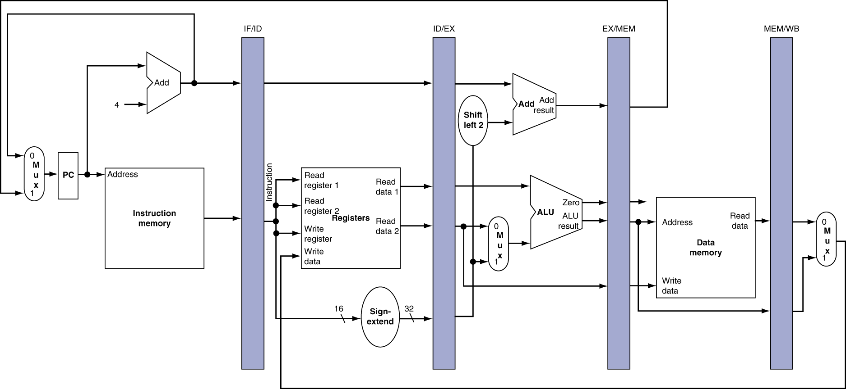
More Detailed Pipeline
lw $3,$2,5
add $6,$5,$4
sw $10,$9,30
beq $11,$12,30
sub $20,$21,$22
Notes:
Morgan Kaufmann Publishers
Chapter 4 — The Processor

Slide 10
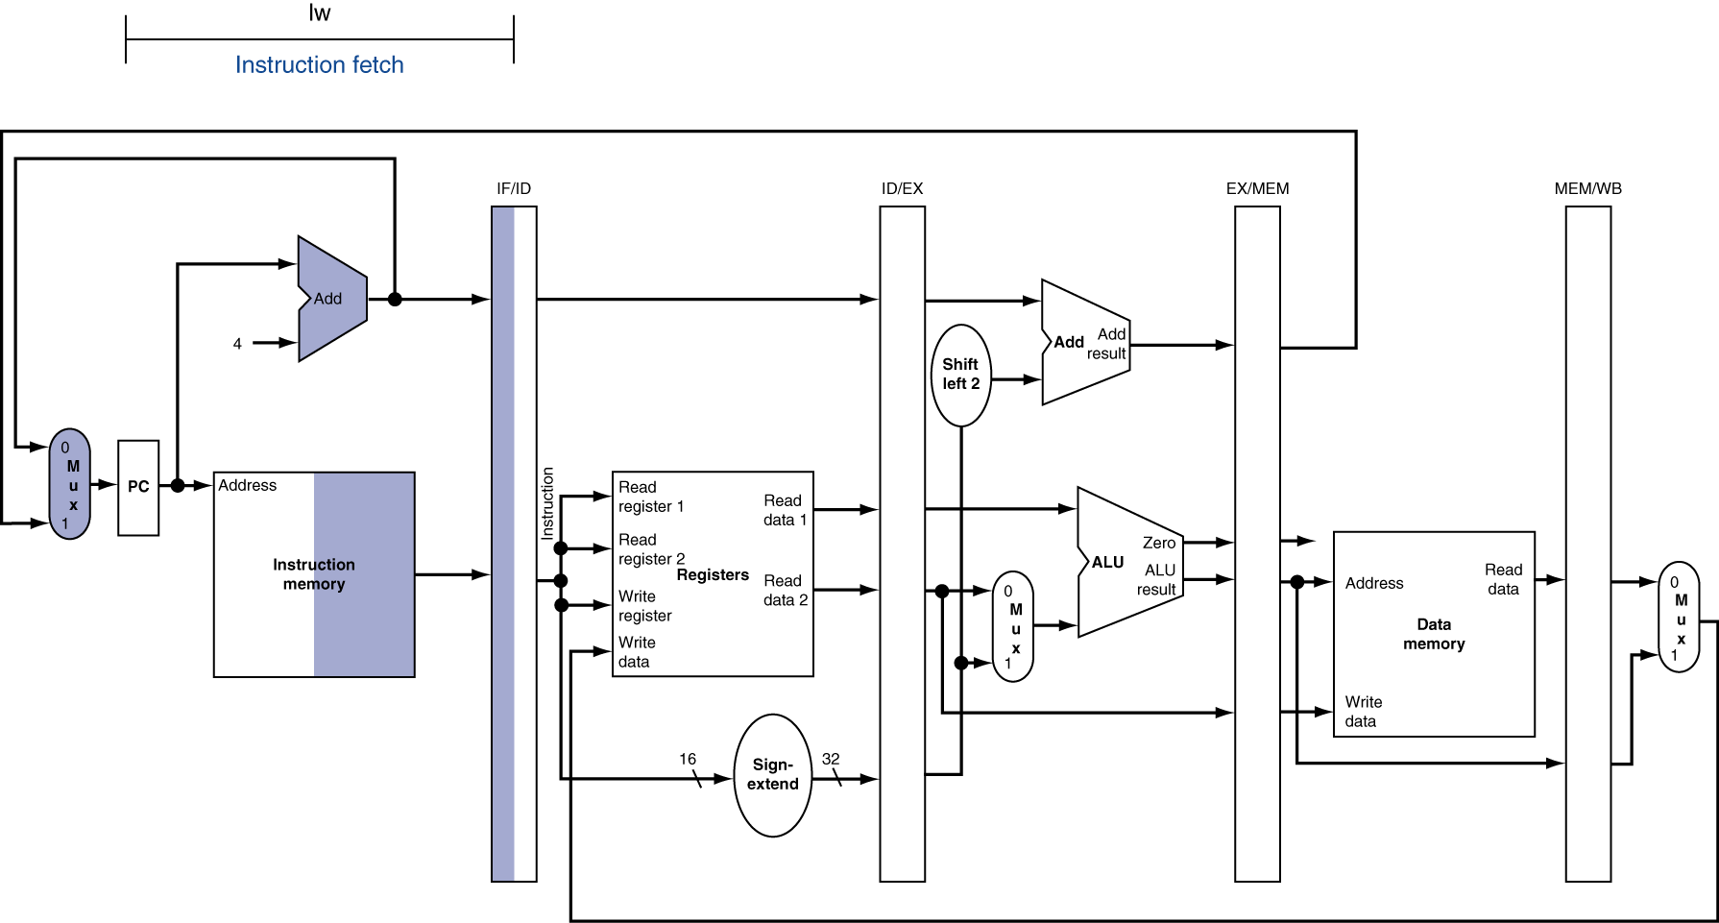
IF for Load, Store, …
lw $3,$2,5
add $6,$5,$4
sw $10,$9,30
beq $11,$12,30
sub $20,$21,$22
取指
Notes:
Morgan Kaufmann Publishers
Chapter 4 — The Processor

Slide 11
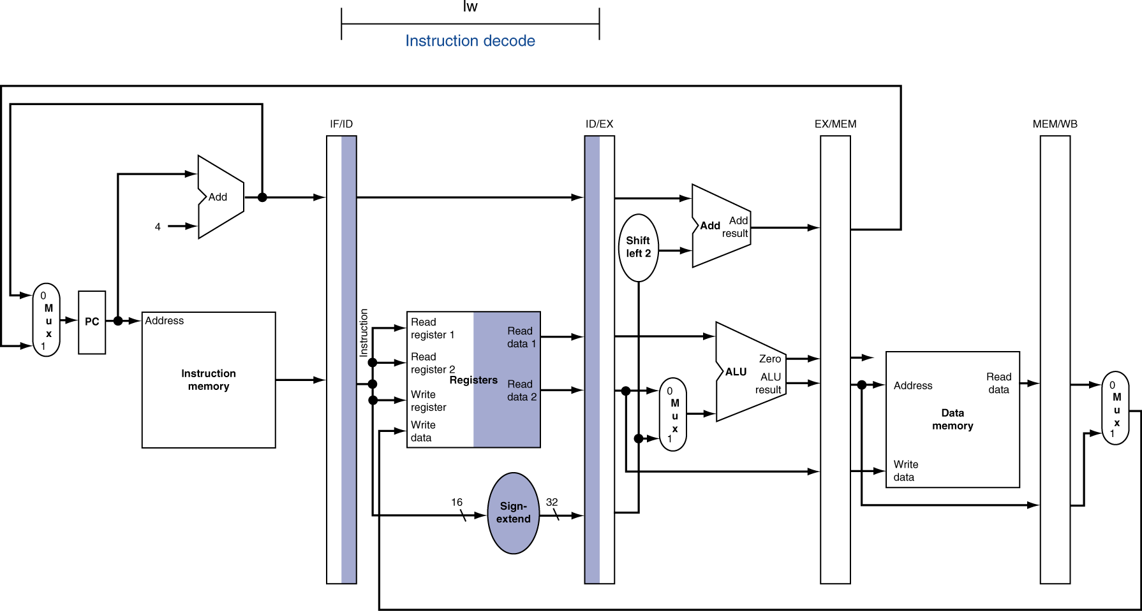
ID for Load, Store, …
lw $3,$2,5
add $6,$5,$4
sw $10,$9,30
beq $11,$12,30
sub $20,$21,$22
add
取指
译码
Notes:
Morgan Kaufmann Publishers
Chapter 4 — The Processor

Slide 12
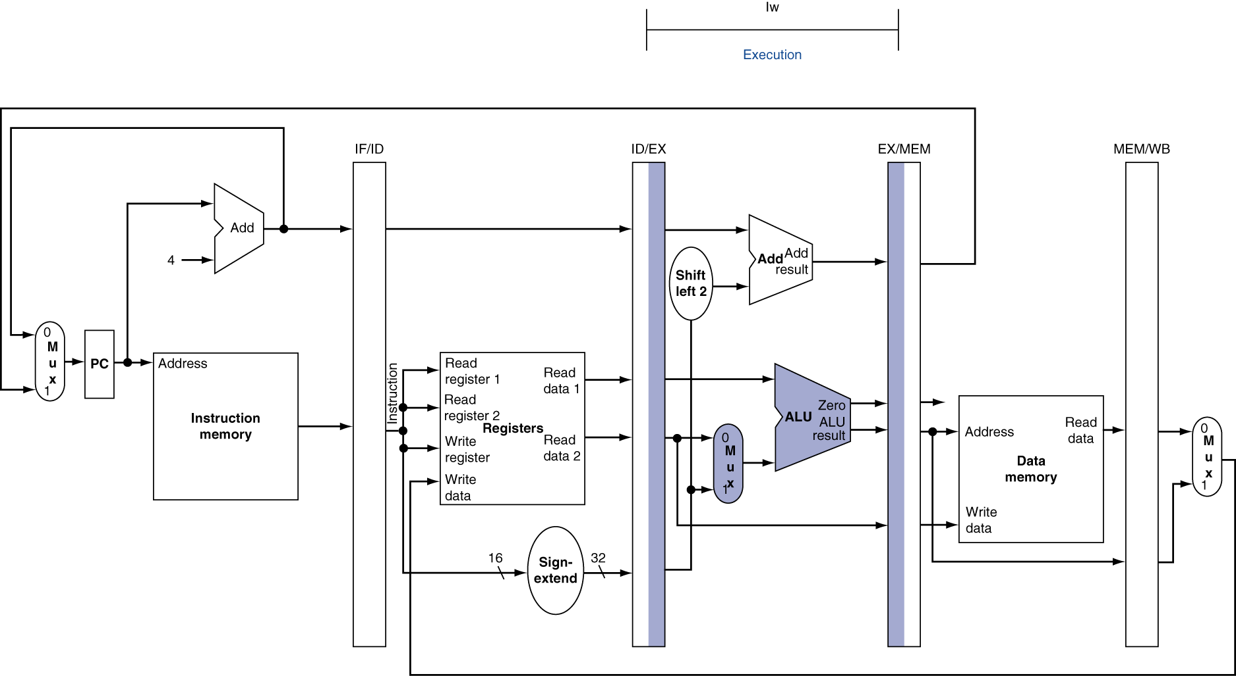
EX for Load
lw $3,$2,5
add $6,$5,$4
sw $10,$9,30
beq $11,$12,30
sub $20,$21,$22
sw
取指
add
译码
执行
Notes:
Morgan Kaufmann Publishers
Chapter 4 — The Processor

Slide 13
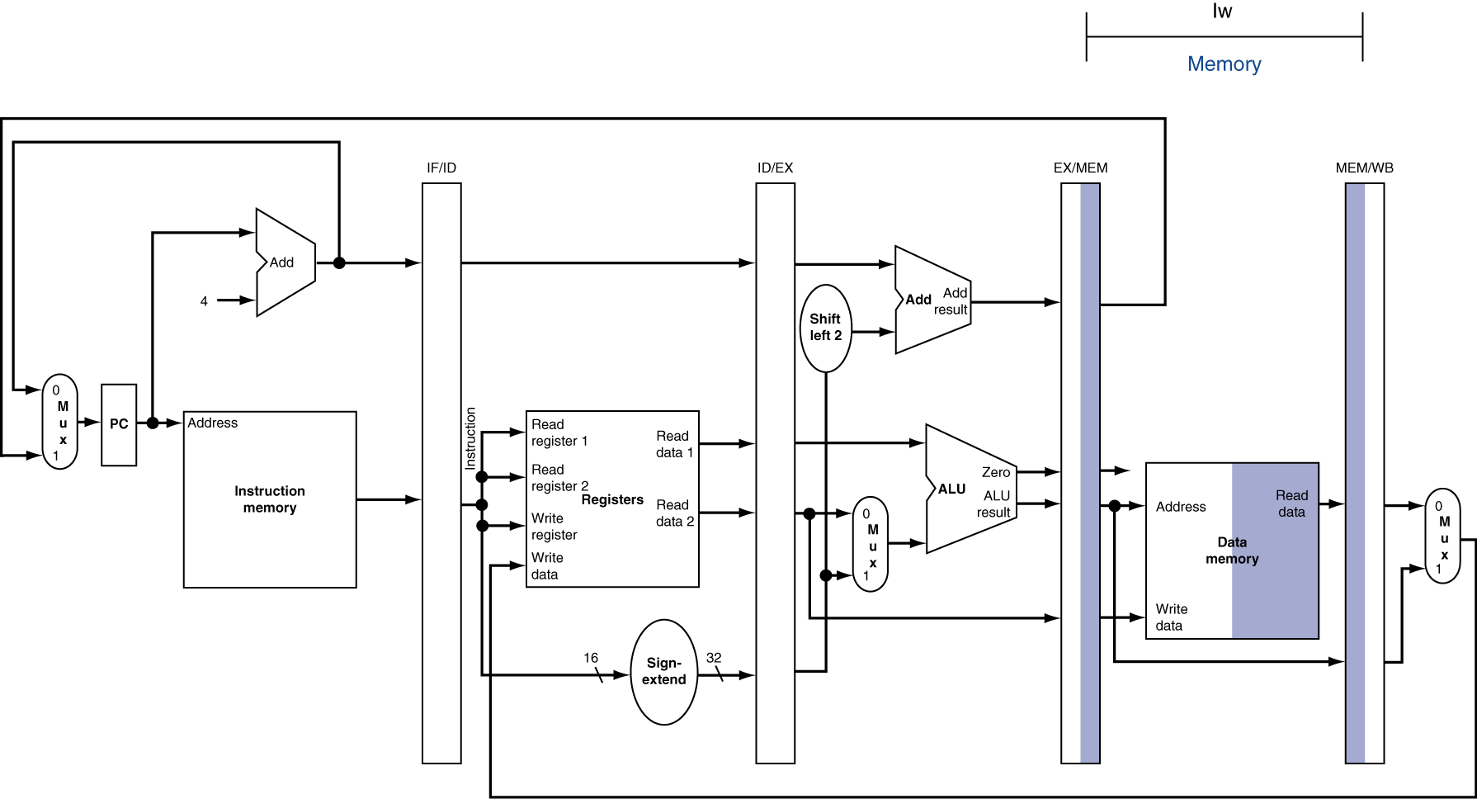
MEM for Load
lw $3,$2,5
add $6,$5,$4
sw $10,$9,30
beq $11,$12,30
sub $20,$21,$22
beq
取指
sw
译码
add
执行
访存
Notes:
Morgan Kaufmann Publishers
Chapter 4 — The Processor

Slide 14
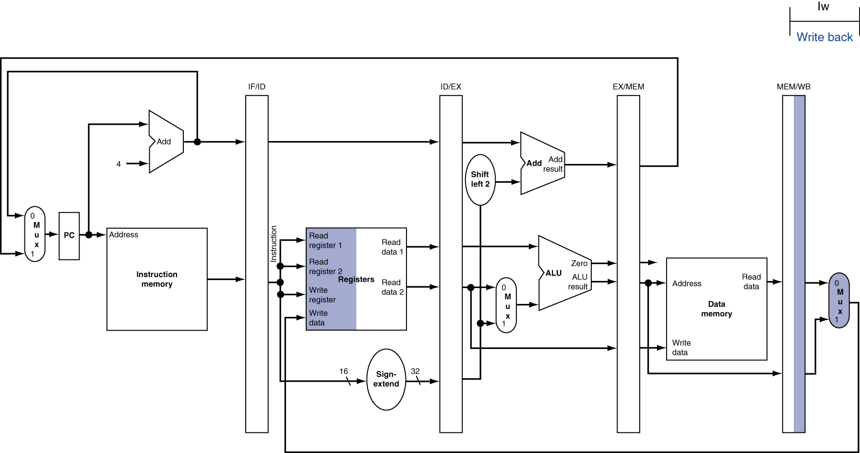
WB for Load
lw $3,$2,5
add $6,$5,$4
sw $10,$9,30
beq $11,$12,30
sub $20,$21,$22
sub
取指
beq
译码
sw
执行
add
访存
回写
Notes:
Morgan Kaufmann Publishers
Chapter 4 — The Processor

Slide 15
复习：Load指令的5个阶段
阶段1
阶段2
阶段 3
阶段 4
阶段5
Ifetch
Reg/Dec
Exec
Mem
Wr
Ifetch (取指) : 取指令并计算PC+4 (用到哪些部件？)
Reg/Dec (取数和译码) : 取数同时译码 (用到哪些部件？)
Exec (执行) : 计算内存单元地址 (用到哪些部件？)
Mem (读存储器) : 从数据存储器中读 (用到哪些部件？)
Wr(写寄存器): 将数据写到寄存器中 (用到哪些部件？)
  指令存储器、Adder
寄存器堆读口、指令译码器
这里寄存器堆的读口和写口可看成两个不同的部件。
扩展器、ALU
数据存储器
寄存器堆写口
Notes:
As shown here, each of these five steps will take one clock cycle to complete.
And in pipeline terminology, each step is referred to as one stage of the pipeline.
+1 = 8 min. (X:48)

Slide 16
单周期指令模型与流水模型的性能比较
假定以下每步操作所花时间为：
    取指：2ns
    寄存器读：1ns
    ALU操作：2ns
    存储器读：2ns
    寄存器写：1ns
单周期模型
  每条指令在一个时钟周期内完成
  时钟周期等于最长的lw指令的执行时间，即：8ns
  串行执行时，N条指令的执行时间为：8Nns
流水线性能
  时钟周期等于最长阶段所花时间为：2ns
  每条指令的执行时间为： 2nsx5=10ns
  N条指令的执行时间为：(4+N)x2ns
  在N很大时，比串行方式提高约 4 倍
  若各阶段操作均衡(例如，各阶段都是2ns)，则提高倍数为5倍。
Load指令执行时间总计为：8ns
(假定控制单元、PC访问、信号传递等没有延迟)
流水线方式下，单条指令执行时间不能缩短，但能大大提高指令吞吐率！

Slide 17
流水线指令集的设计
具有什么特征的指令集有利于流水线执行呢？
  长度尽量一致，有利于简化取指令和指令译码操作
    MIPS指令32位，下址计算方便: PC+4
    X86指令从1字节到17字节不等，使取指部件极其复杂
  格式少，且源寄存器位置相同，有利于在指令未知时就可取操作数
    MIPS指令的rs和rt位置一定，在指令译码时就可读rs和rt的值
    若位置随指令不同而不同，则需先确定指令类型才能取寄存器编号
  load / Store指令才能访问存储器，有利于减少操作步骤，规整流水线
    lw/sw指令的地址计算和运算指令的执行步骤规整在同一个周期
    X86运算类指令操作数可为内存数据，需计算地址、访存、执行
  内存中”对齐”存放，有利于减少访存次数和流水线的规整
  总之，规整、简单和一致等特性有利于指令的流水线执行
31
26
21
16
11
6
0
op
rs
rt
rd
shamt
func
6 bits
5 bits
5 bits
5 bits
5 bits
6 bits

Slide 18
Load指令的流水线
Cycle 1
Cycle 2
Cycle 3
Cycle 4
Cycle 5
Cycle 6
Cycle 7
Clock
1st lw
Ifetch
Reg/Dec
Exec
Mem
Wr
2nd lw
Ifetch
Reg/Dec
Exec
Mem
Wr
3rd lw
Ifetch
Reg/Dec
Exec
Mem
Wr
每个周期有五个功能部件同时在工作
后面指令在前面完成取指后马上开始
每个load指令仍然需要五个周期完成
但是，吞吐率(throughput)提高许多，理想情况下，有：
  每个周期有一条指令进入流水线
  每个周期都有一条指令完成
  每条指令的有效周期(CPI)为1
Notes:
For the load instructions, the five independent functional units in the pipeline datapath are:
(a) Instruction Memory for the Ifetch stage.
(b) Register File’s Read ports for the Reg/Decode stage.
(c) ALU for the Exec stage. (d) Data memory for the Mem stage.
(e) And finally Register File’s write port for the Write Back stage.
Notice that I have treated Register File’s read and write ports as separate functional units because the register file we have allows us to read and write at the same time.
Notice that as soon as the 1st load finishes its Ifetch stage, it no longer needs the Instruction Memory. Consequently, the 2nd load can start using the Instruction Memory (2nd Ifetch).
Furthermore, since each functional unit is only used ONCE per instruction, we will not have any conflict down the pipeline (Exec-Ifet, Mem-Exec, Wr-Mem) either.
I will show you the interaction between instructions in the pipelined datapath later. But for now, I want to point out the performance advantages of pipelining.
If these 3 load instructions are to be executed by the multiple cycle processor, it will take 15 cycles. But with pipelining, it only takes 7 cycles. This (7 cycles), however, is not the best way to look at the performance advantages of pipelining.
A better way to look at this is that we have one instruction enters the pipeline every cycle so we will have one instruction coming out of the pipeline (Wr stages) every cycle.
Consequently, the “effective” (or average) number of cycles per instruction is now ONE even though it takes a total of 5 cycles to complete each instruction.
+3 = 14 min. (X:54)

Slide 19
R-type指令的4个阶段
Cycle 1
Cycle 2
Cycle 3
Cycle 4
R-type
Ifetch
Reg/Dec
Exec
Wr
Ifetch: 取指令并计算PC+4
Reg/Dec: 从寄存器取数，同时指令在译码器进行译码
Exec: 在ALU中对操作数进行计算
Wr: ALU计算的结果写到寄存器
Notes:
Well, so far so good. Let’s take a look at the R-type instructions.
The R-type instruction does NOT access data memory so it only takes four clock cycles, or in our new pipeline terminology, four stages to complete.
The Ifetch and Reg/Dec stages are identical to the Load instructions. Well they have to be because at this point, we do not know we have a R-type instruction yet.
Instead of calculating the effective address during the Exec stage, the R-type instruction will use the ALU to operate on the register operands.
The result of this ALU operation is written back to the register file during the Wr back stage.
+1 = 15 min. (55)

Slide 20
含R-type和 Load 指令的流水线
Cycle 1
Cycle 2
Cycle 3
Cycle 4
Cycle 5
Cycle 6
Cycle 7
Cycle 8
Cycle 9
Clock
R-type
Ifetch
Reg/Dec
Exec
Wr
Ops! We have a problem!
R-type
Ifetch
Reg/Dec
Exec
Wr
Load
Ifetch
Reg/Dec
Exec
Mem
Wr
R-type
Ifetch
Reg/Dec
Exec
Wr
R-type
Ifetch
Reg/Dec
Exec
Wr
上述流水线有个问题: 两条指令试图同时写寄存器，因为
  Load在第5阶段用寄存器写口
  R-type在第4 阶段用寄存器写口
把一个功能部件同时被多条指令使用的现象称为结构冒险(Struture Hazard)
为了流水线能顺利工作，规定：
  每个功能部件每条指令只能用一次（如：写口不能用两次或以上）
  每个功能部件必须在相同的阶段被使用（如：写口总是在第五阶段被使用）
或称为资源冲突！
Notes:
What happened if we try to pipeline the R-type instructions with the Load instructions?
Well, we have a problem here!!!
We end up having two instructions trying to write to the register file at the same time!
Why do we have this problem (the write “bubble”)?
Well, the reason for this problem is that there is something I forget to tell you.
+1 = 16 min. (X:56)

Slide 21
R-type的Wr操作延后一个周期执行
NOOP!
1
2
3
4
5
R-type
Ifetch
Reg/Dec
Exec
Mem
Wr
加一个NOP阶段以延迟“写”操作:
  把“写”操作安排在第5阶段, 这样使R-Type的Mem阶段为空NOP
Clock
Cycle 1
Cycle 2
Cycle 3
Cycle 4
Cycle 5
Cycle 6
Cycle 7
Cycle 8
Cycle 9
R-type
Ifetch
Reg/Dec
Exec
Mem
Wr
R-type
Ifetch
Reg/Dec
Exec
Mem
Wr
Load
Ifetch
Reg/Dec
Exec
Mem
Wr
R-type
Ifetch
Reg/Dec
Exec
Mem
Wr
R-type
Ifetch
Reg/Dec
Exec
Mem
Wr
这样使流水线中的每条指令都有相同多个阶段!
Notes:
Well one thing we can do is to add a “Nop” stage to the R-type instruction pipeline to delay its register file write by one cycle.
Now the R-type instruction ALSO uses the register file’s witer port at its 5th stage so we eliminate the write conflict with the load instruction.
This is a much simpler solution as far as the control logic is concerned. As far as performance is concerned, we also gets back to having one instruction completes per cycle.
This is kind of like promoting socialism: by making each individual R-type instruction takes 5 cycles instead of 4 cycles to finish, our overall performance is actually better off.
The reason for this higher performance is that we end up having a more efficient pipeline.
+1 = 20 min. (Y:00)

Slide 22
Store指令的四个阶段
Cycle 1
Cycle 2
Cycle 3
Cycle 4
NOOP!
Store
Ifetch
Reg/Dec
Exec
Mem
Wr
Ifetch：取指令并计算PC+4
Reg/Dec： 从寄存器取数，同时指令在译码器进行译码
Exec：16位立即数符号扩展后与寄存器值相加，计算主存地址
Mem：将寄存器读出的数据写到主存
Wr: 加一个空的写阶段，使流水线更规整！
Notes:
Let’s continue our lecture by looking at the store instruction.
Once again, the Ifetch and Reg/Decode stages are the same as all other instructions.
The Exec stage of the store instruction calculates the memory address.
Once the address is calculated, the store instruction will write the data it read from the register file back at the Reg/Decode stage into the data memory during the Mem stage.
Notice that unlike the load instruction which takes five cycles to accomplish its task, the Store instruction only takes four cycles or four pipe stages.
In order to keep our pipeline diagram looks more uniform, however, we will keep the Wr stage for the store instruction in the pipeline diagram.
But keep in mind that as far as the pipelined control and pipelined datapath are concerned, the store instruction requires NOTHING to be done once it finishes its Mem stage.
+2 = 27 min. (Y:07)

Slide 23
Beq的四个阶段
Cycle 1
Cycle 2
Cycle 3
Cycle 4
NOOP!
Beq
Ifetch
Reg/Dec
Exec
Mem
Wr
与多周期通路有什么不同？
Ifetch: 取指令并计算PC+4
Reg/Dec:从寄存器取数，同时指令在译码器进行译码
Exec: 执行阶段
  ALU中比较两个寄存器的大小（做减法）
  Adder中计算转移地址
Mem: 如果比较相等, 则：
  转移目标地址写到PC
为什么流水线中不进行“投机”计算？
Wr: 加一个空写阶段，使流水线更规整！
Notes:
Well similar to the store instruction, the branch instruction only consists of four pipe stages.
Ifetch and Reg/decode are the same as all other instructions because we do not know what instruction we have at this point. We have not finish decoding the instruction yet.
During the Execute stage of the pipeline, the BEQ instruction will use the ALU to compare the two register operands it fetched during the Reg/Dec stage.
At the same time, a separate adder is used to calculate the branch target address.
This is difference from M-cycle processor where target address is calculated by ALU but at the 2nd cycle.
If the registers we compared during the Execute stage (point to the last bullet) have the same value, the branch is taken.
That is, the branch target address we calculated earlier (last bullet) will be written into the Program Counter.
Once again, similar to the Store instruction, the BEQ instruction will require NEITHER the pipelined control nor the pipelined datapath to do ANY thing once it finishes its Mem stage.
With all these talk about pipelined datapath and pipelined control, let’s take a look at how the pipelined datapath looks like.
+2 = 29 min. (Y:09)

Slide 24
A Pipelined Datapath（五阶段流水线数据通路）
Clock-to-Q delay
不包含控制逻辑
Clk
Ifetch (IF)
Reg/Dec (ID)
Exec (Ex)
Mem
Wr
有！寄存器写口
RegWr
ExtOp
ALUOp
Branch
1
0
Wr阶段没有DataPath吗？
PC+4
PC+4
PC
PC+4
Imm
Imm
Rs
busA
Zero
Data
Mem
A
Ra
busB
IUnit
Rb
Exec
Unit
RA
Do
IF/ID Register
Ex/Mem Register
Mem/Wr Register
Rt
ID/Ex Register
1
RFile
WA
Mux
Rw
Di
Di
Rt
0
0
I
Rd
1
为什么需要这些Reg？
保存每个周期执行的结果!
属于内部寄存器，对程序员透明，不需作为现场保存
RegDst
ALUSrc
MemWr
MemtoReg
下面看每条指令在流水线通路中的执行过程
Notes:
The pipelined datapath consists of combination logic blocks separated by pipeline registers. If you get rid of all these registers (not the PC), this pipelined datapath is reduced to the single-cycle datapath.
This should give you extra incentive to do a good job on your single cycle processor design homework because you can build your pipeline design based on your single cycle design.
Anyway, the registers mark the beginning and the end of a pipe stage.
In the multiple clock cycle lecture, I recommended that the best way to think about a logic clock cycle is that it begins slightly after the clock tick and ends right at the next clock tick.
For example here, the Reg/Decode stage begins slightly after this clock tick when the output of the IF/ID register has stabilized to its new value AND ends RIGHT at the next clock tick when the output of the register file is clocked into the ID/Exec register.
At the end of the Reg/Decode stage, the register output that just clocked into the ID/Exec register has NOT yet propagate to the register output yet. It takes a Clk-to-Q delay.
When the new value we just clocked in (points to the clock tick) has propagate to the register output, then we have reach the beginning of the Exec stage.
Notice that the Wr stage of the pipeline starts here (last cycle) but there is no corresponding datapath underneath it because the Wr stage of the pipeline is handled by the same part of the pipeline that handles the Register Read stage.
This part of the datapath (Reg File) is the only part that is used by more than one stage of the pipeline. This is OK because the register file has independent Read and Write ports.
More specifically, the Reg/Decode stage of the pipeline uses the register file’s read port while the Write Back stage of the pipeline uses the register file’s write port.
+3 = 32 min. (Y:12)

Slide 25
取指令（Ifetch) 阶段
第10H单元指令: lw $1, 0x100($2) 功能：$1 <- Mem [($2) + 0x100]
You are here!
Clk
Ifetch
Reg/Dec
Exec
Mem
RegWr
ExtOp
ALUOp
Branch
1
0
PC+4
PC+4
PC+4
Imm
Imm
PC = 14
Rs
busA
Zero
Data
Mem
A
Ra
busB
IF/ID: lw $1, 100 ($2)
Exec
Unit
RA
Do
IUnit
Rb
Ex/Mem Register
Mem/Wr Register
Rt
ID/Ex Register
1
RFile
WA
Mux
Rw
Di
Di
I
Rt
0
0
Rd
1
下一目标：设计IUnit（功能是啥？）
RegDst
ALUSrc
MemWr
MemtoReg
先猜一下IUnit中有哪些功能部件？
Notes:
Let’s follow a Load instruction down the pipeline and see how everything works.
Every instruction starts at the Instruction Fetch stage which:
(a) Begins slightly after the first clock tick when PC output has stabilized to its new value.
(b) And ends when the output of the I-Unit is clocked into the IF/ID register.
This picture shows the state of the pipeline at the end of the Ifetch stage (you are here).
Let’s expand this part of the datapath and take a better look.
+1 = 33 min. (Y:13)

Slide 26
指令部件 IUnit的设计
第10H单元指令: : lw $1, 0x100($2) 随后的指令在14H号单元中！
指令部件功能
You are here!
Instr <- Mem[PC]
PC<- PC+4
Clk
Ifetch
Reg/Dec
开始从14H号单元取指！
1
0
这里MUX的控制信号由其他阶段产生！
“4”
流水段寄存器用来存放各阶段的执行结果
总是在下个时钟到来后的Clock-to-Q输出
Adder
PC = 14
10
IF/ID: lw $1, 100 ($2)
Address
PC 新值（14H） ≠旧输出（10H）
Instruction
Memory
应把哪些信息存到流水段寄存器IF/ID中？
Instruction
应保存后面阶段用到的指令和PC+4的值！
取指阶段有哪些控制信号？
不需控制信号，因为每条指令执行功能一样，是确定的，无需根据指令的不同来控制执行不同的操作！
指令在随后阶段被送出译码！
PC+4用来计算转移目标地址
Notes:
Let’s assume the Load instruction we are following is in memory location TEN, 10.
So the Ifetch stage begins shortly after the first clock tick when the value 10 appears on the Program Counter register output.
This is used as the address to access the Instruction Memory and at the same time it is fed to the adder so it can be increment by four.
At the end of the Ifetch stage, this clock tick will clock the output of the instruction memory, which is the Load instruction, into the If/ID pipeline register.
As the same time, the PC plus 4 value, that is 14 in this case, will be clocked into the PC.
Notice that the picture here shows the stage of the pipeline at the END of the Ifetch stage (you are here) so the number 14, even though is already latched into the register, will not appear at the PC output until Clk-to-Q time later.
Similarly, the load instruction we just clocked into the IF/ID register will NOT appear at the register output until a Clk-toQ delay after this clock.
And when it appears at the IF/iD register output, we will be in the Reg/Decode stage.
+2 = 35 min. (Y:15)

Slide 27
译码/取数（Reg/Dec）阶段
Location 10H: lw $1, 0x100($2) 功能：$1 <- Mem[($2) + 0x100]
You are here!
Clk
Ifetch
Reg/Dec
Exec
Mem
RegWr
ExtOp
ALUOp
Branch
1
RegWr是Wr段的信号
0
PC+4
PC+4
PC
PC+4
IF/ID:
Imm
Imm
Rs
busA
Zero
Data
Mem
A
Ra
busB
ID/Ex: Reg. 2 & 0x100
IUnit
Rb
Exec
Unit
RA
Do
Ex/Mem Register
Mem/Wr Register
指令还要存ID/EX中吗？
不要，只要存相关信息
Rt
1
RFile
WA
Mux
Rt
Rw
Di
Di
I
0
0
Rd
1
Reg[Rs],Reg[Rt],Rt,Rd,Imm16,PC+4等被保存在ID/EXE中
RegDst
ALUSrc
MemWr
MemtoReg
该阶段有哪些控制信号？
没有！因是所有指令的公共操作，故无控制信号！
Notes:
This picture shows the state of the pipeline at the end of Load’s Reg/Decode stage.
All the datapath has to do is read register (Ra and busA) R2 from the register file.
As the same time, we need to pass the Immediate field of the instruction onto the next stage (ID/Exec) register because the immediate field is needed for address calculation.
Let’s concentrate on the load instruction (point to the 1st bullet) going down the pipe and ignore what is in the PC and IF/ID registers for now.
Since we are here (Your are Here), Register R2 and Imm16 have already clocked into ID/Exec register but they have not yet appeared at the register’s output.
+1 = 36 min. (Y:16)

Slide 28
Load指令的地址计算阶段
Location 10H: lw $1, 0x100($2) 功能：$1 <- Mem[($2) + 0x100]
指令已被译码，可确定执行部件的控制信号！
You are here!
Clk
Ifetch
Reg/Dec
Exec
Mem
ALUOp=？
RegWr
ExtOp=？
Branch
1
0
PC+4
PC+4
PC
PC+4
IF/ID:
Imm
Imm
Rs
busA
Zero
Data
Mem
A
Ra
busB
Rb
Exec
Unit
RA
IUnit
Ex/Mem: Load’s Address
Do
ID/Ex Register
Mem/Wr Register
Rt
1
RFile
WA
Mux
Rt
Rw
Di
Di
I
0
0
Rd
1
目的寄存器Rt不传递下去会怎样？
连接到错误的目的地址，指令执行错误！
RegDst=0
ALUSrc=？
MemWr
MemtoReg
下一目标：设计执行部件(Exec Unit)
猜有哪些部件？
Notes:
If we wait a little bit longer (beginning of Exe), Register R2 and Imm16 will appear at the ID/Exec register output and we are now in the Exec stage where we will calculate the Memory Address for the load instruction.
Notice that besides calculating the Load’s Memory Address, we also need to pass the Rt field (RegDst = 0) of the instruction down the pipeline.
The reason is that we will need to use Rt field later on to specify which register to write to when we reach the end of the Load pipeline.
Also notice that this is the first stage of the pipeline that requires any control signals.
We will talk more about this (Rt field and other control signals) later but for now, let’s expand this part of the datapath and take a closer look at what is going on.
+2 = 38 min. (Y:18)

Slide 29
执行部件（Exec Unit）的设计
执行部件功能？
计算内存地址
计算转移目标地址
一般ALU运算
You are here!
Clk
Exec
Mem
Adder用于计算分支指令的转移地址
Load指令的各控制信号取值？
<< 2
Target
RegDes=0, ALUSrc=1 ALUop=addu, Extop=1
Adder
32
PC+4
Store指令呢？
busA
32
ID/Ex Register
32
Zero
RegDes=x, ALUSrc=1 ALUop=addu, Extop=1
Ex/Mem: Load’s Memory Address
busB
ALU
ALUout
0
32
Branch指令呢？
32
Mux
RegDes=x, ALUSrc=0 ALUop=subu, Extop=1
imm
3
ALUctr
Extender
1
16
32
ALU
Ori指令呢？
Control
func
6
ExtOp=?
ALUSrc=?
3
RegDes=0, ALUSrc=1 ALUop=or, Extop=0
ALUOp=?
R型指令呢？
RegDes=1, ALUSrc=0 ALUop=‘func’, Extop=x
Notes:
At the beginning of the Exec cycle, ID/Exec register’s output will be stabilized to Register R2 (bus A) and Imm16.
By setting the control signals ExtOp and ALUSrc to 1s, the 16-bit immediate field will be sign extended to 32 bits and pass onto the ALU.
The ALU then add (ALUOp = Add) this sign extended version of the Immediate field to Register 2 (busA) to form the memory address.
By the end of the Exec cycle (you are here), the ALU output will be valid and will be stored into the Exec/Mem pipeline register.
This Memory Address (Exec/Mem) will appear at the output of the Exec/Mem register a Clk-to-Q time after this clock tick (you are here).
+1 = 39 min. (Y:19)

Slide 30
Load指令的存储器读(Mem)周期
Location 10H: lw $1, 0x100($2) 功能： $1 <- Mem[($2) + 0x100]
You are here!
Clk
Ifetch
Reg/Dec
Exec
Mem
RegWr
ExtOp
ALUOp
Branch=0
1
0
PC+4
PC+4
PC
PC+4
IF/ID:
Imm
Imm
Rs
busA
Zero
Data
Mem
A
Ra
busB
Rb
Exec
Unit
RA
Do
IUnit
ID/Ex Register
Ex/Mem Register
Mem/Wr: Load’s Data
Rt
1
RFile
WA
Mux
Rw
Di
Di
Rt
0
0
I
Rd
1
RegDst
ALUSrc
MemWr=0
MemtoReg
该阶段有反向数据流，可能会引起冒险！以后介绍。
Notes:
And it will be used to read the Data Memory (RA).
By setting the clock cycle time longer than the data memory read access time, we can guarantee the memory output (Do) will be stable by the end of the Mem cycle (you are here).
And this clock tick will trigger the Mem/Wr register to latch in Load’s data.
We have to pass the Load instruction’s Rt field down the pipeline one more time because we still have not use it yet.
+1 = 40 min. (Y:20)

Slide 31
Load指令的回写（Write Back）阶段
Location 10H: lw $1, 0x100($2) 功能：$1 <- Mem[($2) + 0x100]
Clk
Ifetch
Reg/Dec
Exec
Mem
Wr
RegWr=1
ExtOp
ALUOp
Branch
1
0
PC+4
PC+4
PC
PC+4
IF/ID:
Imm
Imm
Rs
busA
Zero
Data
Mem
A
Ra
busB
IUnit
Rb
Exec
Unit
RA
Do
ID/Ex Register
Ex/Mem Register
Mem/Wr Register
Rt
1
RFile
WA
Mux
Rw
Di
Di
Rt
0
0
I
Rd
1
该阶段有反向数据流，可能会引起冒险！以后介绍。
RegDst
ALUSrc
MemWr
MemtoReg=1
各阶段所经DataPath已有，控制信号如何得到？
Notes:
The Rt filed of the load instruction will be used in the Register Write back stage of the pipeline (Wr) to specified the register (Rw) where the load data is written.
Since we are writing the load’s data into the register file, the control signal MemtoReg and RegWr must be set to 1.
So this finishes the grand tour of how a load instruction flows through the datapath.
But how about control signals?
+1 = 41 min. (Y:21)

Slide 32
流水线中的Control Signals如何获得?
主要考察: 第N阶段的控制信号，它取决于是某条指令的某个阶段。
  N = Exec, Mem, Wr (只有这三个阶段有控制信号）
  例: Load的Exec段的控制信号 = Func (Load’s Exec)
Ifetch
Reg/Dec
Exec
Mem
Wr
ALUOp=Add
RegWr
ExtOp=1
Branch
1
0
PC+4
PC+4
PC+4
IF/ID:
I16
Imm
PC
Rs
busA
Zero
Data
Mem
A
Ra
busB
Rb
Exec
Unit
RA
Do
IUnit
ID/Ex Register
Ex/Mem: Load’s Address
Mem/Wr Register
Rt
1
RFile
WA
Mux
Rw
Di
Di
Rt
0
0
I
Rd
1
为什么 1st 和 2nd 阶段没有控制信号?
ALUSrc=1
RegDst=0
MemWr
MemtoReg
IF和ID阶段的功能对每条指令来说都一样
Notes:
The key observation about the control signals is that the control signals at Stage N depends ONLY on the instruction that is currently in Stage N, where N is either Exec, Mem, or Wr (points to the control signals at each stage, especially RegWr at Wr stage).
Notice that I did not mention anything about the Ifet and Dec stage because there cannot be any instruction dependent control signals at these two stages. Why?
Because at these two stages (Ifetch and Dec) we do not know what instructions we have yet: we have just fetch the instruction (Ifetch) and is still in the process of decoding it (Dec).
Here is an example of this rule (1st bullet). During the Load instruction’s Exec stage, the control signals (ExtOp, ALUSrc, ALUOp) in the Exec stage are set this way because this is the setting required to do the right things for Load instruction's Exec stage.
Since the control signals depend ONLY on the instruction that is currently in that stage of the pipeline (1st Bullet), the control is very similar to the Controller for the single cycle processor.
The difference is that after we generate the control signals, we need to pipeline them so they are applied to the correct stage of the pipeline (Exec, Mem, an Wr) when the instruction reaches that stage.
Let me show you what I mean by this.
+2 = 43 min. (Y:23)

Slide 33
Load指令:流水线中的控制信号
在取数/译码（Reg/Dec）阶段产生本指令每个阶段的所有控制信号
  Exec信号 (ExtOp, ALUSrc, ...) 在1个周期后使用
  Mem信号 (MemWr, Branch) 在2个周期后使用
  Wr信号 (MemtoReg, RegWr) 在3个周期后使用
所以，控制信号也要保存在流水段寄存器中！
Reg/Dec
Exec
Mem
Wr
ExtOp
ExtOp
ALUSrc
ALUSrc
ALUOp
ALUOp
Main
Control
RegDst
RegDst
Ex/Mem Register
IF/ID Register
MemWr
ID/Ex Register
MemWr
MemWr
Mem/Wr Register
Branch
Branch
Branch
MemtoReg
MemtoReg
MemtoReg
MemtoReg
RegWr
RegWr
RegWr
RegWr
各流水段部件在一个时钟内完成某条指令的某个阶段的工作！
在下个时钟到达时，把执行结果以及前面传递来的后面各阶段要用到的所有数据（如：指令、立即数、目的寄存器等）和控制信号保存到流水线寄存器中！
Notes:
The main control here is identical to the one in the single cycle processor. It generate all the control
signals necessary for a given instruction during that instruction’s Reg/Decode stage.
All these control signals will be saved in the ID/Exec pipeline register at the end of the Reg/Decode cycle.
The control signals for the Exec stage (ALUSrc, ... etc.) come from the output of the ID/Exec register. That is they are delayed ONE cycle from the cycle they are generated.
The rest of the control signals that are not used during the Exec stage is passed down the pipeline and saved in the Exec/Mem register.
The control signals for the Mem stage (MemWr, Branch) come from the output of the Exec/Mem register. That is they are delayed two cycles from the cycle they are generated.
Finally, the control signals for the Wr stage (MemtoReg & RegWr) come from the output of the Exec/Wr register: they are delayed three cycles from the cycle they are generated.
+2 = 45 min. (Y:45)

Slide 34
流水线中的Control Signals
通过对前面流水线数据通路的分析，得知：
  PC需要写使能吗？
  流水段寄存器需要写使能吗？
  Ifecth阶段和Dec/Reg阶段都没有控制信号
  Exec阶段的控制信号有四个
    ExtOp (扩展器操作)：1- 符号扩展；0- 零扩展
    ALUSrc (ALU的B口来源)：1- 来源于扩展器；0- 来源于BusB
    ALUOp (主控制器输出，用于辅助局部ALU控制逻辑来决定ALUCtrl)
    RegDst (指定目的寄存器)：1- Rd；0- Rt
  Mem阶段的控制信号有两个
    MemWr (DM的写信号)：Store指令时为1，其他指令为0
    Branch (是否为分支指令)：分支指令时为1，其他指令为0
  Wr阶段的控制信号有两个
    MemtoReg (寄存器的写入源)：1- DM输出；0- ALU输出
    RegWr (寄存器堆写信号)：结果写寄存器的指令都为1，其他指令为0
  每个时钟都会改变PC，故不需要!
  每个时钟都会改变流水段寄存器，故不需要!
Notes:
The key observation about the control signals is that the control signals at Stage N depends ONLY on the instruction that is currently in Stage N, where N is either Exec, Mem, or Wr (points to the control signals at each stage, especially RegWr at Wr stage).
Notice that I did not mention anything about the Ifet and Dec stage because there cannot be any instruction dependent control signals at these two stages. Why?
Because at these two stages (Ifetch and Dec) we do not know what instructions we have yet: we have just fetch the instruction (Ifetch) and is still in the process of decoding it (Dec).
Here is an example of this rule (1st bullet). During the Load instruction’s Exec stage, the control signals (ExtOp, ALUSrc, ALUOp) in the Exec stage are set this way because this is the setting required to do the right things for Load instruction's Exec stage.
Since the control signals depend ONLY on the instruction that is currently in that stage of the pipeline (1st Bullet), the control is very similar to the Controller for the single cycle processor.
The difference is that after we generate the control signals, we need to pipeline them so they are applied to the correct stage of the pipeline (Exec, Mem, an Wr) when the instruction reaches that stage.
Let me show you what I mean by this.
+2 = 43 min. (Y:23)

Slide 35
控制逻辑 Control)的设计
流水线控制逻辑的设计
  每条指令的控制信号在该指令执行期间变不变？
  与单周期的控制逻辑设计类似
  设计过程
    控制逻辑分成两部分
      主控制逻辑：生成ALUop和其他控制信号
      局部ALU控制逻辑：根据ALUop和func字段生成ALUCtrl
    用真值表建立指令和控制信号之间的关系
    写出每个控制信号的逻辑表达式
  控制逻辑的输出（控制信号）在ID阶段生成，并存放在ID/EX流水段寄存器中，然后每来一个时钟跟着指令传送到下一级流水段寄存器
  某时刻在不同阶段同时执行不同指令，不同的指令得到不同控制信号
不变！

Slide 36
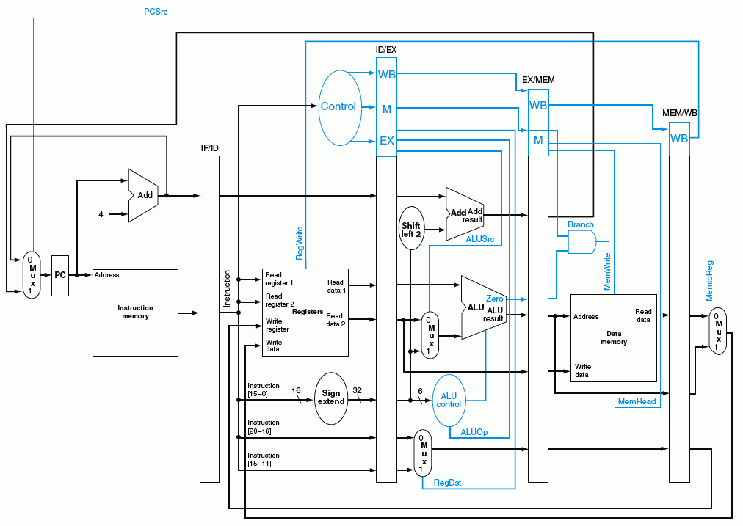
蓝色部分是控制信号

Slide 37
Load指令:流水线中的控制信号
在取数/译码（Reg/Dec）阶段产生本指令每个阶段的所有控制信号
  Exec信号 (ExtOp, ALUSrc, ...) 在1个周期后使用
  Mem信号 (MemWr, Branch) 在2个周期后使用
  Wr信号 (MemtoReg, RegWr) 在3个周期后使用
所以，控制信号也要保存在流水段寄存器中！
Reg/Dec
Exec
Mem
Wr
ExtOp
ExtOp
ALUSrc
ALUSrc
ALUOp
ALUOp
Main
Control
RegDst
RegDst
IF/ID Register
ID/Ex Register
Ex/Mem Register
Mem/Wr Register
MemWr
MemWr
MemWr
Branch
Branch
Branch
MemtoReg
MemtoReg
MemtoReg
MemtoReg
RegWr
RegWr
RegWr
RegWr
保存在流水段寄存器中的信息（包括前面阶段传递来或执行的结果及控制信号）一起被传递到下一个流水段！
Notes:
The main control here is identical to the one in the single cycle processor. It generate all the control
signals necessary for a given instruction during that instruction’s Reg/Decode stage.
All these control signals will be saved in the ID/Exec pipeline register at the end of the Reg/Decode cycle.
The control signals for the Exec stage (ALUSrc, ... etc.) come from the output of the ID/Exec register. That is they are delayed ONE cycle from the cycle they are generated.
The rest of the control signals that are not used during the Exec stage is passed down the pipeline and saved in the Exec/Mem register.
The control signals for the Mem stage (MemWr, Branch) come from the output of the Exec/Mem register. That is they are delayed two cycles from the cycle they are generated.
Finally, the control signals for the Wr stage (MemtoReg & RegWr) come from the output of the Exec/Wr register: they are delayed three cycles from the cycle they are generated.
+2 = 45 min. (Y:45)

Slide 38
流水线举例：考察流水线DataPath的数据流动情况
Cycle 1
Cycle 2
Cycle 3
Cycle 4
Cycle 5
Cycle 6
Cycle 7
Cycle 8
Clock
0: Load
Ifetch
Reg/Dec
Exec
Mem
Wr
4: R-type
Ifetch
Reg/Dec
Exec
Mem
Wr
8: Store
Ifetch
Reg/Dec
Exec
Mem
Wr
12: Beq (target is 1000)
Ifetch
Reg/Dec
Exec
Mem
Wr
考察以下几个点的情况：
End of
Cycle 4
End of
Cycle 5
End of
Cycle 6
End of
Cycle 7
End of Cycle 4: Load’s Mem, R-type’s Exec, Store’s Reg, Beq’s Ifetch
End of Cycle 5: Load’s Wr, R-type’s Mem, Store’s Exec, Beq’s Reg
End of Cycle 6: R-type’s Wr, Store’s Mem, Beq’s Exec
End of Cycle 7: Store’s Wr, Beq’s Mem
说明：后面仅考察数据流动情况，控制信号随数据同步流动不再说明。
Notes:
Well, let’s look at a more complex example so I can show you how different instructions at different stages of execution can be processed by our pipelined datapath simultaneously.
Let’s consider the following instruction sequence: Load, R-type, Store, and then Branch on equal to target address 1000.
In the next four slides, I will show you the state of the datapath at the end of Cycle 4, Cycle 5, Cycle 6 and Cycle 7.
First let’s take a look at the end of Cycle 4 where:
(a) The Load instruction has just finished its Mem stage.
(b) The R-type instruction has just finished its Exec stage.
(c) The Store instruction has just finished its Register Fetch slash Instruction Decode stage.
(d) And finally, the Branch instruction has just finish fetching the instruction.
Remember now, the next four pictures we will be looking at are at the end of a clock cycle. That is right at the clock tick.
+2 = 59 min. (Y:39)

Slide 39
第四周期结束时的状态：
0: Load’s Mem 4: R-type’s Exec 8: Store’s Reg 12: Beq’s Ifetch
12: Beq’s Ifet
8: Store’s Reg
4: R-type’s Exec
0: Load’s Mem
?’s Wr
ALUOp=R-type
RegWr=?
ExtOp=x
Branch=0
Load指令前某指令
Clk
1
0
PC+4
PC+4
PC+4
Imm
Imm
PC = 16
Rs
busA
Zero
Data
Mem
A
Ra
busB
IF/ID: Beq Instruction
Exec
Unit
RA
Do
Rb
Mem/Wr: Load’s Dout
IUnit
ID/Ex: Store’s busA & B
Ex/Mem: R-type’s Result
1
Rt
RFile
WA
Di
Mux
Rt
Rw
Di
I
0
0
Rd
1
RegDst=1
ALUSrc=0
Clk
MemtoReg=?
MemWr=0
在黑板上画Exec Unit
Notes:
So the internal value of the register has just been updated BUT the output of the register, due to the Clock-to-Q delay, has NOT been changed to reflect the new internal value.
The output of the register will still has the value from the cycle that has just ended.
For example, look at Ifetch stage of the pipeline. The output of PC will still have the values of 12, the location of the Branch instruction even though PC has been updated to 16.
Furthermore, the IF/ID register’s internal value have already been updated to the Branch instruction even though its output still contains the Store instruction so that we can read the registers (Ra and Rb) for the store instruction and store their values into the ID/Ex register.
In order to get ready for calculating the store address, we also needs to pass the immediate field to the next stage.
At the end of Cycle 4, the Exec stage of the pipeline have just completed the ALUOp for the R-type instruction so the ALU output is stored into the Exec/Mem register.
Notice that for R-type instruction, the Rd field of the instruction is used to specify the destination register so the RegDst control signal must be set to 1 to pass Rd down the pipe.
The Mem stage of the pipeline have just completed the data memory read access for the load instruction so the data to be loaded can be found in the Mem/Wr register.
In the pipeline diagram, I did not show any instruction prior to the load instruction so we do NOT have any instruction in the Wr stage yet (MemtoReg=X, RegWr=0).
So far so good. Let’s take a look at what happened at the next clock cycle.
+3 = 62 min. (Y:42)

Slide 40
第五周期结束时的状态：
0: Lw’s Wr 4: R’s Mem 8: Store’s Exec 12: Beq’s Reg 16: R’s Ifetch
16: R’s Ifet
12: Beq’s Reg
8: Store’s Exec
4: R-type’s Mem
0: Load’s Wr
ALUOp=Addu
RegWr=1
ExtOp=1
Branch=0
Clk
1
0
PC+4
PC+4
PC+4
Imm
Imm
20
PC = 16
Rs
busA
Zero
Data
Mem
A
Ra
busB
Rb
Exec
Unit
RA
Do
IF/ID: Instruction @ 16
ID/Ex: Beq’s busA & B
Ex/Mem: Store’s Address
Mem/Wr: R-type’s Result
IUnit
Rt
1
RFile
WA
Mux
Rw
Di
Di
Rt
0
0
I
Rd
1
RegDst=x
ALUSrc=1
Clk
MemtoReg=1
寄存器的写口和读口可看成是独立的两个部件！
MemWr=0
Notes:
Well we are now at the END of Cycle 5. Looking at Ifetch stage of the pipeline. The output of PC will still have the values of 16even though PC has been updated to 20.
I have assumed the instruction at memory location 16 to be a R-type instruction so the IF/ID register’s internal value will contain this R-type instruction even though its output still contains the Branch instruction that has just completed its Register Fetch stage (ID/Ex).
In order to get ready for calculating the branch target address, we also needs to pass the immediate field to the next stage.
At the end of Cycle 5, the Exec stage of the pipeline has just completed the address calculation for the Store instruction which involves adding the sign extended (ExtOp=1) version of the Immediate field (ALUSrcA) to the Rs register (busA).
This Store address is stored in the Ex/Mem register so it can be used in the next clock cycle.
Notice that for R-type instruction, the Mem stage is a NoOp stage. All we do is to pass the ALU output AS WELL AS the Rd field from the ID/Ex register to the Mem/Wr register.
At the end of Cycle 5, the Wr stage of the pipeline has just completed the Register File write for the load instruction
Therefor, RegWr is set to 1 for the register write and MemtoReg is set to 1 to route the data memory output we saved from last cycle (output of Mem/Wr register) to the register file.
+3 = 65 min. (Y:45)

Slide 41
第六周期结束时的状态：
4: R’s Wr 8: Store’s Mem 12: Beq’s Exec 16: R’s Reg 20: R’s Ifet
20:R-type’s Ifet
16: R-type’s Reg
12: Beq’s Exec
8: Store’s Mem
4: R-type’s Wr
ALUOp=Subu
RegWr=1
ExtOp=1
Branch=0
Clk
1
0
PC+4
PC+4
PC+4
Imm
Imm
PC = 24
Rs
busA
Zero
Data
Mem
A
Ra
busB
Rb
Exec
Unit
RA
Do
IF/ID: Instruction @ 20
ID/Ex:R-type’s busA & B
Ex/Mem: Beq’s Results
Mem/Wr: Nothing for St
IUnit
Rt
1
RFile
WA
Mux
Rw
Di
Di
Rt
0
0
I
Rd
1
RegDst=x
ALUSrc=0
Clk
MemtoReg=0
MemWr=1
Notes:
Now, let take a look at the end of Cycle 6.
The Branch instruction has just completed its Exec stage so the signal Zero will be asserted if the two registers (busA and busB) we compared (ALUOp=sub) are equal.
This value of Zero (2nd from top) as well as the branch target address (top), that is the sum of PC+4 and the sign extended version (ExtOp=1) of the immediate filed , must be stored in the Ex/Mem register (Beq’s result).
The Mem stage of the pipeline has just completed the operation for the store instruction where the value from bus B is stored (MemWr=1) into the memory address location specified by the ALU output.
The Wr stage of the pipeline has just completed the operation for the R-type instruction.
Therefore MemtoReg is set to zero to route the ALU output we saved in the Mem/Reg register to the register file where RegWrite is set to 1 to complete the write.
+2 = 47 min. (Y:47)

Slide 42
第七周期结束时的状态：
8: Store’s Wr 12: Beq’s Mem 16: R’s Exec 20: R’s Reg 24: R’s Ifet
24:R-type’s Ifet
20: R-type’s Reg
16: R-type’s Exec
12: Beq’s Mem
8: Store’s Wr
ALUOp=R-type
RegWr=0
ExtOp=x
Branch=1
Clk
1
0
PC+4
PC+4
PC+4
Imm
Imm
PC = 1000
Rs
busA
Zero
Data
Mem
A
Ra
busB
Rb
Exec
Unit
Do
IF/ID: Instruction @ 24
ID/Ex:R-type’s busA & B
Ex/Mem: Rtype’s Results
Mem/Wr:Nothing for Beq
IUnit
RA
1
假定相等，
则Zero=1
转移目标地址送PC!
Rt
RFile
WA
Di
Mux
Rt
Rw
Di
I
0
0
Rd
1
这里出现反向数据流!
转移目标地址反向送给PC可能会导致控制冒险！
RegDst=1
ALUSrc=0
Clk
MemtoReg=x
MemWr=0
Notes:
Finally, let’s take a look at the end of Cycle 7 where the Branch instruction has just completed its Mem stage.
I have assumed the registers we compared in the last cycle are indeed equal so ALU output Zero was asserted and captured in the Ex/Mem register.
With Zero asserted and the control signal Branch set to 1, the branch target address we calculated in Cycle 6 and saved in the Ex/Mem register is now written into the PC (1000).
By writing the branch target address into the Program Counter, we have just completed the branch instruction.
+2 = 69 min. (Y:49)

Slide 43
第一讲内容小结
指令的执行可以像洗衣服一样，用流水线方式进行
  均衡时指令吞吐率提高N倍，但不能缩短一条指令的执行时间
  流水段数以最复杂指令所需步骤数为准（有些指令的某些阶段为空操作），每个阶段的宽度以最复杂阶段所需时间为准（尽量调整使各阶段均衡）
以Load指令为准，分为五个阶段
  取指令段(IF)
    取指令、计算PC+4（IUnit：Instruction Memory、Adder）
  译码/读寄存器(ID/RF)段
    指令译码、读Rs和Rt（寄存器读口）
  执行(EXE)段
    计算转移目标地址、ALU运算（Extender、ALU、Adder）
  存储器(MEM)段
    读或写存储单元（Data Memory）
  写寄存器(Wr)段
    ALU结果或从DM读出数据写到寄存器（寄存器写口）
流水线控制器的实现
  IF和ID/RF段不需控制信号控制，只有EXE、MEM和Wr需要
  ID段生成所有控制信号，并随指令的数据同步向后续阶段流动
寄存器和存储器的竞争问题可利用时钟信号来解决
流水线冒险：结构冒险、控制冒险、数据冒险
（下一讲主要介绍解决流水线冒险的数据通路如何设计）

Slide 44
第二讲 流水线冒险的处理
主 要 内 容
流水线冒险的几种类型
数据冒险的现象和对策
  数据冒险的种类
    相关的数据是ALU结果：可以通过转发解决
    相关的数据是DM读出的内容：随后的指令需被阻塞一个时钟
  数据冒险和转发
    转发检测 / 转发控制
  数据冒险和阻塞
    阻塞检测 / 阻塞控制
控制冒险的现象和对策
  静态分支预测技术
  动态分支预测技术
  缩短分支延迟技术

Slide 45
总结：流水线的三种冲突/冒险（Hazard）情况
Hazards：指流水线遇到无法正确执行后续指令或执行了不该执行的指令
  Structural hazards (hardware resource conflicts):
  现象：同一个部件同时被不同指令所使用
    一个部件每条指令只能使用1次，且只能在特定周期使用
    设置多个部件，以避免冲突。如指令存储器IM 和数据存储器DM分开
  Data hazards (data dependencies):
  现象：后面指令用到前面指令结果数据时，前面指令的结果还没产生
    采用转发(Forwarding/Bypassing)技术
    Load-use冒险需要一次阻塞(stall)
    编译程序优化指令顺序
  Control (Branch) hazards (changes in program flow):
  现象：转移或异常改变执行流程，后继指令在目标地址产生前已被取出
    采用静态或动态分支预测
    编译程序优化指令顺序(分支延迟)
SKIP

Slide 46
Structural Hazard（结构冒险）现象
Time (clock cycles)
Load
Mem
Reg
ALU
Mem
Reg
Instr 1
Mem
Reg
ALU
Mem
Reg
Instr 2
Mem
Reg
ALU
Mem
Reg
Instr 3
Mem
Reg
ALU
Mem
Reg
Instr 4
Mem
Reg
ALU
Mem
Reg
只有一个存储器时，在Load指令取数据同时又取指令的话，则发生冲突！
如果不对寄存器堆的写口和读口独立设置的话，则发生冲突！
结构冒险也称硬件资源冲突：同一个执行部件被多条指令使用。

Slide 47
Structural Hazard的解决方法
为了避免结构冒险，规定流水线数据通路中功能部件的设置原则为：
每个部件在特定的阶段被用！（如：ALU总在第三阶段被用！）
将Instruction Memory (Im) 和 Data Memory (Dm)分开
将寄存器读口和写口独立开来
Time (clock cycles)
I
n
s
t
r.
O
r
d
e
r
Load
Im
Reg
ALU
Dm
Reg
Instr 1
Im
Reg
ALU
Dm
Reg
BACK
Instr 2
Im
Reg
ALU
Dm
Reg
Instr 3
Im
Reg
ALU
Dm
Reg
Instr 4
Im
Reg
ALU
Dm
Reg

Slide 48
Data Hazard现象
举例说明：以下指令序列中，寄存器r1会发生数据冒险
想一下，哪条指令的r1是老的值？
哪条是新的值？
add r1 ,r2,r3
sub r4, r1 ,r3
读r1时，add指令正在执行加法(EXE)，老值!
and r6, r1 ,r7
读r1时，add指令正在传递加法结果(MEM), 老值!
or r8, r1 ,r9
读r1时，add指令正在写加法结果到r1(WB), 老值!
xor r10, r1 ,r11
读r1时，add指令已经把加法结果写到r1, 新值
画出流水线图能很清楚理解！
补充：三类数据冒险现象
RAW: 写后读（基本流水线中经常发生，如上例）
WAR：读后写（基本流水线中不会发生，乱序执行时会发生）
WAW：写后写（基本流水线中不会发生，乱序执行时会发生）
本讲介绍基本流水线，所以仅考虑RAW冒险

Slide 49
Data Hazard on r1
Time (clock cycles)
IF
ID/RF
EX
MEM
WB
add r1,r2,r3
Im
Reg
ALU
Dm
Reg
I
n
s
t
r.
O
r
d
e
r
sub r4,r1,r3
Im
Reg
ALU
Dm
Reg
and r6,r1,r7
Im
Reg
ALU
Dm
Reg
or r8,r1,r9
Im
Reg
ALU
Dm
Reg
xor r10,r1,r11
Im
Reg
ALU
Dm
Reg
最后一条指令的r1才是新的值！
如何解决这个问题？

Slide 50
数据冒险的解决方法
方法1：硬件阻塞（stall）
方法2：软件插入“NOP”指令
方法3：合理实现寄存器堆的读/写操作（不能解决所有数据冒险）
  前半时钟周期写，后半时钟周期读，若同一个时钟内前面指令写入的数据正好是后面指令所读数据，则不会发生数据冒险
方法4：转发（Forwarding或Bypassing 旁路）技术
    若相关数据是ALU结果，则如何？
    可通过转发解决
    若相关数据是上条指令DM读出内容，则如何？
    不能通过转发解决，随后指令需被阻塞一个时钟 或 加NOP指令
方法5：编译优化：调整指令顺序（不能解决所有数据冒险）
称为Load-use数据冒险！
实现“转发”和“阻塞” 要修改数据通路：
（1）检测何时需要“转发” ，并控制实现“转发”
（2）检测何时需要“阻塞”，并控制实现“阻塞”

Slide 51
方案1: 在硬件上采取措施，使相关指令延迟执行
硬件上通过阻塞(stall)方式阻止后续指令执行，延迟到有新值以后！
这种做法称为流水线阻塞，也称为插入“气泡Bubble”
Time (clock cycles)
IF
ID/RF
EX
MEM
WB
add r1,r2,r3
Im
Reg
ALU
Dm
Reg
I
n
s
t
r.
O
r
d
e
r
stall
Im
bubble
bubble
bubble
bubble
stall
Im
bubble
bubble
bubble
bubble
stall
Im
bubble
bubble
bubble
bubble
sub r4,r1,r3
Im
Reg
Dm
Reg
ALU
and r6,r1,r7
Im
Reg
Dm
ALU
缺点：控制比较复杂，需要改数据通路；指令被延迟三个时钟执行。
Notes:
The same instruction means the same one as the first instruction add r1, r2, r3 . So the remaining instructions are not affected.

Slide 52
方案 2: 软件上插入无关指令
由编译器插入三条NOP指令，浪费三条指令的空间和时间，是最差的做法。
好处：数据通路简单，即无需改数据通路。
Time (clock cycles)
IF
ID/RF
EX
MEM
WB
add r1,r2,r3
Im
Reg
ALU
Dm
Reg
I
n
s
t
r.
O
r
d
e
r
nop
Im
Reg
ALU
Dm
Reg
nop
Im
Reg
ALU
Dm
Reg
nop
Im
Reg
ALU
Dm
Reg
sub r4,r1,r3
Im
Reg
Dm
Reg
ALU
and r6,r1,r7
Im
Reg
ALU
Dm
与方案1比，哪个更快？
一样，都是多三个时钟周期！

Slide 53
方案3: 同一周期内寄存器堆先写后读
寄存器堆的读口和写口是相互独立的部件！
Time (clock cycles)
IF
ID/RF
EX
MEM
WB
add r1,r2,r3
Im
Reg
ALU
Dm
Reg
I
n
s
t
r.
O
r
d
e
r
sub r4,r1,r3
Im
Reg
ALU
Dm
Reg
and r6,r1,r7
Im
Reg
ALU
Dm
Reg
or r8,r1,r9
Im
Reg
ALU
Dm
Reg
xor r10,r1,r11
Im
Reg
ALU
Dm
Reg
寄存器写口/读口分别在前/后半周期进行操作，使写入数据被直接读出
但是，只能解决部分数据冒险！

Slide 54
方法4: 利用DataPath中的中间数据：转发+阻塞
Time (clock cycles)
IF
ID/RF
EX
MEM
WB
add r1,r2,r3
Im
Reg
ALU
Dm
Reg
I
n
s
t
r.
O
r
d
e
r
sub r4,r1,r3
Im
Reg
ALU
Dm
Reg
and r6,r1,r7
Im
Reg
ALU
Dm
Reg
or r8,r1,r9
Im
Reg
ALU
Dm
Reg
xor r10,r1,r11
Im
Reg
ALU
Dm
Reg
仔细观察后发现：流水段寄存器中早已有需要的值r1！
在哪个流水段R中？
把数据从流水段寄存器中直接取到ALU的输入端,称为转发或旁路（Bypassing）
    若相关数据是上条指令从DM读出内容，能转发吗？
不能，因为它送入段寄存器前，后条指令要在ALU中用。
    因此，后条指令需被阻塞一个时钟 或 加NOP指令。
    这种数据冒险称为Load-use数据冒险

Slide 55
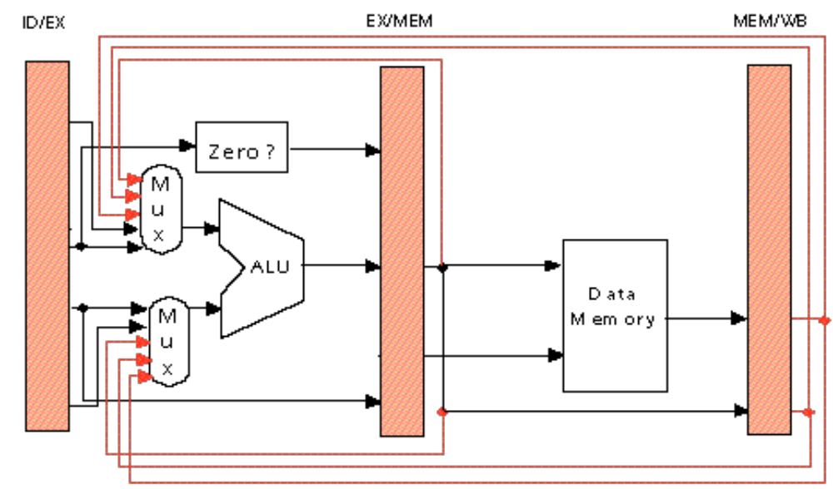
硬件上的改动以支持“转发”技术
加MUX，使流水段寄存器值返送ALU输入端
Ex
Mem
add r3, r2, r1
sub r5, r3, r4
lw r3, 100(r1)
or r6, r2, r1
sub r5, r3, r4
ALU
DM
add r3, r2, r1
or r6, r2, r1
sub r5, r3, r4
如果指令序列为
lw r3, 100(r1)
or r6, r3, r1
sub r5, r3, r4
能用“转发”技术解决第1、2两条指令间的数据冒险吗？
请看后面的幻灯片！
Notes:
Why do we need the orange-color forwarding? See the following examples. The result of present instruction(1st one) is needed by next next instruction(3rd one).
Add R3, R2, R1 Add R3, R2, R1
Add R5, R4, R3 Lw R5, 100(R3)
Add R6, R5, R3 Add R6, R5, R3
Add R7, R6, R3
What is the meaning of the 2nd bullet? It means that register read of R3 gets the new result of register write R3 in the 1st instruction. That is, the 4th instruction can get the result of the 1st instruction without forwarding.

Slide 56
“Forwarding”技术使Load-use冒险只需延迟一个周期
Time (clock cycles)
IF
ID/RF
EX
MEM
WB
lw r1, 0(r2)
Im
Reg
ALU
Dm
Reg
I
n
s
t
r.
O
r
d
e
r
sub r7,r1,r3
Im
Reg
ALU
Dm
Reg
and r6,r1,r7
Im
Reg
ALU
Dm
Reg
or r8,r1,r9
Im
Reg
ALU
Dm
Reg
采用“转发”后仅第二条指令 SUB r7,r1,r3 不能按时执行！
发生“装入- 使用数据冒险”时，需要对load后的指令阻塞一个时钟周期！
数据冒险处理最佳方案：“转发” + “Load-use阻塞”

Slide 57
RAW（写后读）数据冒险的“转发”条件
Ex
Mem
C3
C1
ori r3, r2, 100
sub r5, r3, r4
lw r3, 100(r1)
or r6, r2, r1
sub r5, r3, r4
C2
add r3, r2, r1
or r6, r2, r1
sub r5, r3, r4
后面指令需用ALU输出结果
C1: 目寄是后一条指令的源寄
C2: 目寄是后第二条指令的源寄
(例如：R-Type后跟R- / lw / sw / beq等)
后面指令需用从DM读出的结果
C3: 目寄是后第二指令的源寄
(例如：load指令后跟R-Type / beq等)
用流水段寄存器来表示转发条件（C3以后考虑）
C1(a): EX/MEM. RegisterRd=ID/EX. RegisterRs
C1(b): EX/MEM. RegisterRd=ID/EX. RegisterRt
C2(a): MEM/WB. RegisterRd=ID/EX. RegisterRs
C2(b): MEM/WB. RegisterRd=ID/EX. RegisterRt
这里的RegisterRd是指目的寄存器
实际上是R-type的Rd 或 I-Type的Rt
Notes:
Why do we need the orange-color forwarding? See the following examples. The result of present instruction(1st one) is needed by next next instruction(3rd one).
Add R3, R2, R1 Add R3, R2, R1
Add R5, R4, R3 Lw R5, 100(R3)
Add R6, R5, R3 Add R6, R5, R3
Add R7, R6, R3
What is the meaning of the 2nd bullet? It means that register read of R3 gets the new result of register write R3 in the 1st instruction. That is, the 4th instruction can get the result of the 1st instruction without forwarding.

Slide 58
转发条件的进一步完善
beq r3, r2, 100
add r4, r3, r2
sub r5, r3, r2
以下两种情况下，转发会发生错误
  指令的结果不写入目的寄存器Rd时
    例如，Beq指令只对rs和rt相减，不写结果到目的寄存器Rt
    即：EX / MEM 或 MEM / WB 流水段寄存器的RegWr信号为0
  Rd等于$0时
    例如，指令 sll $0, $1, 2 的转发结果为(R[$1]<<2) ，但实际上应该是0
因此，修改转发条件为：
  C1(a): EX/MEM.RegWr
  and EX/MEM. RegisterRd ≠ 0
  and EX/MEM. RegisterRd=ID/EX. RegisterRs
  C1(b): EX/MEM.RegWr
  and EX/MEM. RegisterRd ≠ 0
  and EX/MEM. RegisterRd=ID/EX. RegisterRt
  C2(a): MEM/WB.RegWr
  and MEM/WB. RegisterRd ≠ 0
  and MEM/WB. RegisterRd=ID/EX. RegisterRs
  C2(b): MEM/WB.RegWr
  and MEM/WB. RegisterRd ≠ 0
  and MEM/WB. RegisterRd=ID/EX. RegisterRt

Slide 59
转发路径和转发条件
加MUX，使流水段寄存器值返送ALU输入端
Ex
Mem
C1反映本条指令和随后指令间的相关关系
C2反映本条指令和随后第二条指令间的相关关系
C1(a)
C3
C2(a)
C2(b)
C1(b)
红线和兰线可以合并，在原数据通路中确实是合并在一起的。记得吗？
由一个二路选择器（控制端为MemtoReg）合并输出到寄存器堆！
所以, 无需另有一个检测条件C3! C3就是C2！
C1和C2分别反映哪两条指令的关系呢？
Notes:
Why do we need the orange-color forwarding? See the following examples. The result of present instruction(1st one) is needed by next next instruction(3rd one).
Add R3, R2, R1 Add R3, R2, R1
Add R5, R4, R3 Lw R5, 100(R3)
Add R6, R5, R3 Add R6, R5, R3
Add R7, R6, R3
What is the meaning of the 2nd bullet? It means that register read of R3 gets the new result of register write R3 in the 1st instruction. That is, the 4th instruction can get the result of the 1st instruction without forwarding.

Slide 60
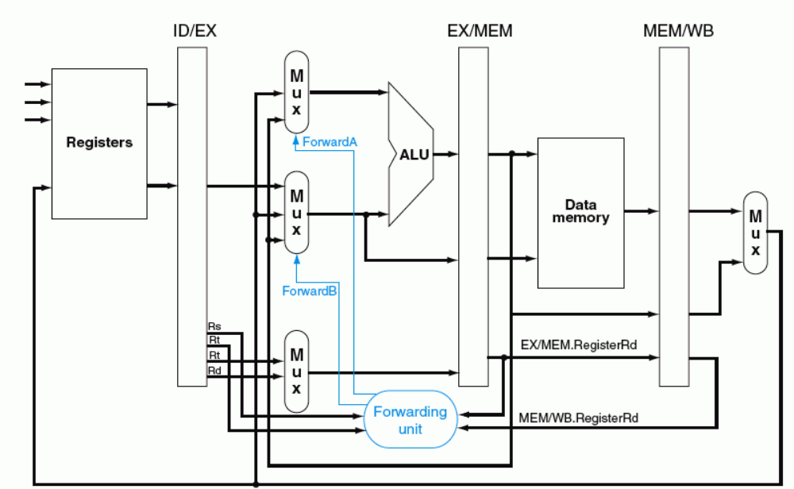
转发路径和转发条件
ForwardA (ForwardB) =
01 当c2(a)=1 或C2(b)=1 时
10 当c1(a)=1或C1(b)=1 时
C1
C2
“转发检测”部件中缺何条件？
MEM/WB.RegWr=1、EX/MEM.RegWr=1

Slide 61
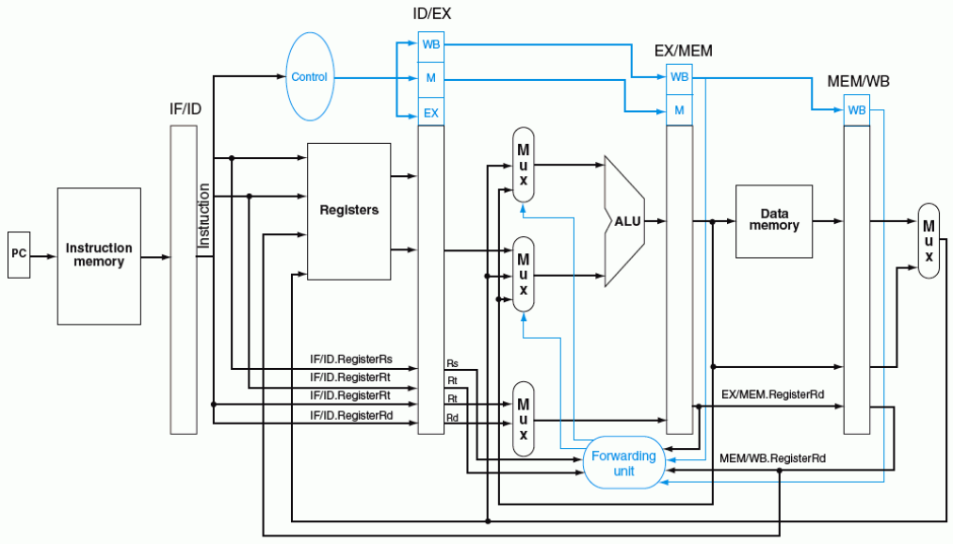
带转发的流水线数据通路
ForwardA
ForwardB

Slide 62
Load-use Data Hazard（硬件阻塞方式）
阻塞前的情况：
Time (clock cycles)
I
n
s
t
r.
O
r
d
e
r
IF
ID
EX
MEM
WB
lw r1, 0(r2)
Im
Reg
ALU
Dm
Reg
sub r4,r1,r3
检测点
Im
Reg
ALU
Dm
Reg
and r6,r1,r7
阻塞点
Im
Reg
Dm
Reg
ALU
or r8,r1,r9
Im
Reg
ALU
Dm
Reg
检测“阻塞”过程中：
1) sub指令在IF/ID寄存器中，并正被译码，控制信号和Rs/Rt的值将被写到ID/EX段寄存器
2) and指令地址在PC中，正被取出，取出的指令将被写到IF/ID段寄存器中
在阻塞点，必须将上述两条指令的执行结果清除，并延迟一个周期执行这两条指令
延迟一个周期执行后面指令，相当于把阻塞点前面一个周期的状态再保持一个周期
lw指令还是继续正常执行下去
想想看，lw后面的指令如何做到继续保持状态？

Slide 63
Load-use Data Hazard（硬件阻塞方式）
Time (clock cycles)
阻塞后的情况：
IF
ID/RF
EX
MEM
WB
I
n
s
t
r.
O
r
d
e
r
lw r1, 0(r2)
Reg
Reg
Im
ALU
Dm
sub r4,r1,r3
检测点
Im
Reg
bubble
bubble
bubble
sub r4,r1,r3
阻塞点
Im
Reg
Dm
Reg
ALU
and r6,r1,r7
Im
Reg
ALU
Dm
Reg
or r8,r1,r9
Im
Reg
ALU
Dm
Reg
在阻塞点，将上述两条指令的执行结果清除，并延迟一个周期执行这两条指令
① 将ID/EX段寄存器中所有控制信号清0 ，插入一个“气泡”
② IF/ID寄存器中的信息不变（还是sub指令），sub指令重新译码执行
③ PC中的值不变（还是and指令地址），and指令重新被取出执行

Slide 64
Load-use Data Hazard（硬件阻塞方式）
Time (clock cycles)
IF
ID/RF
EX
MEM
WB
lw r1, 0(r2)
Reg
ALU
Reg
I
n
s
t
r.
O
r
d
e
r
Im
Dm
sub r4,r1,r3
检测点
Im
Reg
bubble
bubble
bubble
sub r4,r1,r3
阻塞点
Im
Reg
Dm
Reg
ALU
and r6,r1,r7
Im
Reg
ALU
Dm
Reg
or r8,r1,r9
Im
Reg
ALU
Dm
Reg
需解决以下问题：
(1) 判断什么条件下需要阻塞
  ID/EX.MemRead
  and (ID/EX.RegisterRt=IF/ID.RegisterRs
  or ID/EX.RegisterRt=IF/ID.RegisterRt)
前面指令为Load 并且
前面指令的目的寄存器等于当前刚取出指令的源寄存器
(2) 如何修改数据通路来实现阻塞

Slide 65
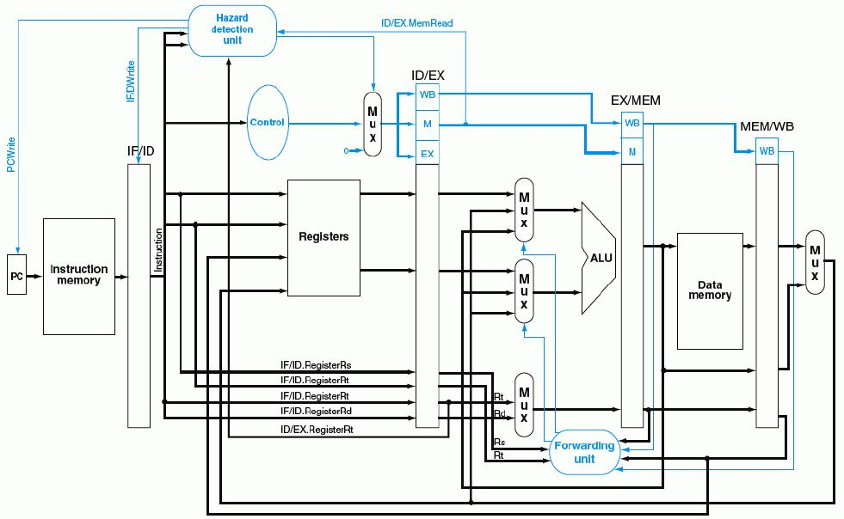
带“转发”和“阻塞”检测的流水线数据通路
  ID/EX.MemRead and (ID/EX.RegisterRt=IF/ID.RegisterRs or ID/EX.RegisterRt=IF/ID.RegisterRt)
使控制信号清0，阻塞指令执行！
①
“写使能”信号为0，使PC和IF/ID不变
②
0
③
至此，硬件处理数据冒险（转发+阻塞）全部完成！

Slide 66
Control Hazard的解决方法
方法1：硬件上阻塞（stall）分支指令后三条指令的执行
  使后面三条指令清0或 其操作信号清0，以插入三条NOP指令
方法2：软件上插入三条“NOP”指令
（以上两种方法的效率太低，需结合分支预测进行）
方法3：分支预测（Predict）
  简单（静态）预测：
    总是预测条件不满足(not taken)，即：继续执行分支指令的后续指令
    可加启发式规则：在特定情况下总是预测满足(taken)，其他情况总是预测不满足。如：循环顶部（底部）分支总是预测为不满足（满足）。能达65%-85%的预测准确率
  动态预测：
    根据程序执行的历史情况进行动态预测调整，能达90%的预测准确率
注：流水线控制必须确保被错误预测指令的执行结果不能生效，而且要能从正
确的分支地址处重新启动流水线工作
方法4：延迟分支（Delayed branch）（通过编译程序优化指令顺序！）
  把分支指令前面与分支指令无关的指令调到分支指令后执行，也称延迟转移
另一种控制冒险：异常或中断控制冒险的处理

Slide 67
简单（静态）分支预测方法
基本做法
  总预测条件不满足(not taken)，即：继续执行分支指令的后续指令
    可加启发式规则：
    在特定情况下总是预测满足(taken)，其他情况总是预测不满足
  预测失败时，需把流水线中三条错误预测指令丢弃掉
    将被丢弃指令的控制信号值或指令设置为0
    （注：涉及到当时在IF、ID和EX三个阶段的指令）
性能
  如果转移概率是50%，则预测正确率仅有50%
预测错误的代价
  预测错误的代价与何时能确定是否转移有关。越早确定代价越少
  是否可以把“是否转移”的确定工作提前，而不等到MEM阶段才确定？
可以！
那最早可以提前到哪个阶段呢？
SKIP

Slide 68
复习: Control Hazard现象
Cycle 4
Cycle 5
Cycle 6
Cycle 7
Cycle 8
Cycle 9
Cycle 10
Cycle 11
Clk
12: Beq
(target is 1000)
Ifetch
Reg/Dec
Exec
Mem
Wr
16: R-type
Ifetch
Reg/Dec
Exec
Mem
Wr
20: R-type
Ifetch
Reg/Dec
Exec
Mem
Wr
24: R-type
Ifetch
Reg/Dec
Exec
Mem
Wr
1000: Target of Br
Ifetch
Reg/Dec
Exec
Mem
Wr
虽然Beq指令在第四周期取出，但:
  “是否转移”在Mem阶段确定，目标地址在第七周期才被送到PC输入端
  第八周期才取出目标地址处的指令执行
  结果：在取目标指令之前，已有三条指令被取出，取错了三条指令！
发生转移时，要在流水线中清除Beq后面的三条指令，分别在EXE 、ID、 IF段中
延迟损失时间片C：发生转移时，给流水线带来的延迟损失
BACK
这里 C=3
Notes:
Notice that although the branch instruction is fetched during Cycle 4, its target address is NOT written into the Program Counter until the end of clock Cycle 7.
Consequently, the branch target instruction is not fetched until clock Cycle 8.
In other words, there is a 3-instruction delay between the branch instruction is issued and the branch effect is felt in the program.
This is referred to as Branch Hazard in the text book.
And as we will show in the next lecture, by clever design techniques, we can reduce the delay to ONE instruction.
That is if the branch instruction in Location 12 is issued in Cycle 4, we will only execute one more sequential instruction (Location 16) before the branch target is executed.
+2 = 71 min. (Y:51)

Slide 69
第七周期结束时的状态：
8: Store’s Wr 12: Beq’s Mem 16: R’s Exec 20: R’s Reg 24: R’s Ifet
24:R-type’s Ifet
20: R-type’s Reg
16: R-type’s Exec
12: Beq’s Mem
8: Store’s Wr
ALUOp=R-type
RegWr=0
ExtOp=x
Branch=1
Clk
1
0
PC+4
PC+4
PC+4
Imm
Imm
PC = 1000
Rs
busA
Zero
Data
Mem
A
Ra
busB
Rb
Exec
Unit
Do
IF/ID: Instruction @ 24
ID/Ex:R-type’s busA & B
Ex/Mem: Rtype’s Results
Mem/Wr:Nothing for Beq
IUnit
RA
1
假定相等，
则Zero=1
转移目标地址送PC!
Rt
RFile
WA
Di
Mux
Rt
Rw
Di
I
0
0
Rd
1
转移目标地址反向送给PC可能会导致控制冒险！
RegDst=1
ALUSrc=0
Clk
MemtoReg=x
IF.Flush=Branch and Zero
ID. IF.Flush=Branch and Zero
MemWr=0
Notes:
Finally, let’s take a look at the end of Cycle 7 where the Branch instruction has just completed its Mem stage.
I have assumed the registers we compared in the last cycle are indeed equal so ALU output Zero was asserted and captured in the Ex/Mem register.
With Zero asserted and the control signal Branch set to 1, the branch target address we calculated in Cycle 6 and saved in the Ex/Mem register is now written into the PC (1000).
By writing the branch target address into the Program Counter, we have just completed the branch instruction.
+2 = 69 min. (Y:49)

Slide 70
简单（静态）分支预测方法
缩短分支延迟，减少错误预测代价
  可以将 “转移地址计算”和“分支条件判断”操作调整到ID阶段来缩短延迟
    将转移地址生成从MEM阶段移到ID阶段，可以吗？为什么？
    （是可能的：IF/ID流水段寄存器中已经有PC的值和立即数）
    将“判0”操作从EX阶段移到ID阶段，可以吗？为什么？
    （用逻辑运算(如，先按位异或，再结果各位相或)来直接比较Rs和Rt的值）
    （简单判断用逻辑运算，复杂判断可以用专门指令生成条件码）
    （许多条件判断都很简单）
预测错误的检测和处理（称为“冲刷、冲洗” -- Flush）
  当Branch=1并且Zero=1时，发生转移（taken）
  增加控制信号：IF.Flush=Branch and Zero，取值为1时，说明预测失败
  预测失败 (条件满足) 时，完成以下两件事（延迟损失时间片C=1时）：
    将转移目标地址->PC
    清除IF段中取出的指令，即：将IF/ID中的指令字清0，转变为nop指令
原来要清除三条指令，调整后只需要清除一条指令，因而只延迟一个时钟周期，每次预测错误减少了两个周期的代价！
即：这里 C=1

Slide 71
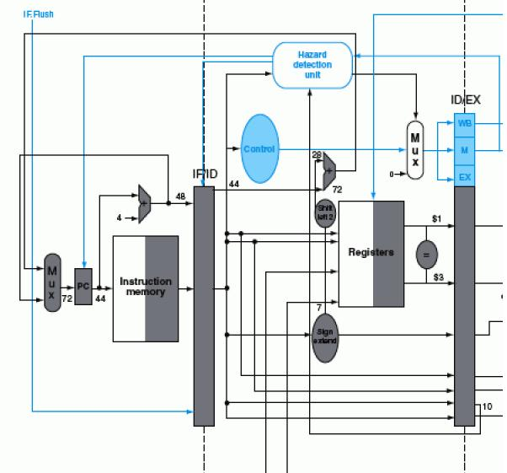
带静态分支预测处理的数据通路
sub $3, $5, $1 add $1, $5, $2
beq $1, $3, 7
IF.Flush=Branch and Zero
40#指令“beq $1,$3,7” ID段
转移目址
(72)->PC
控制转移
目址->PC
IF/ID中指令字清0，变为nop指令
若$1或$3和前面指令数据相关，会怎么样？
上上条指令的EXE段结果可转发回来进行判断
上条指令的EXE段结果来不及转发回来，引起1次阻塞!
需重新改“转发”条件和转发线路！
BACK

Slide 72
动态分支预测方法
简单的静态分支预测方法的预测成功率不高，应考虑动态预测
动态预测基本思想：
  利用最近转移发生的情况，来预测下一次可能转移还是不转移
  根据实际情况来调整预测
  转移发生的历史情况记录在BHT中（有多个不同的名称）
    分支历史记录表BHT（Branch History Table）
    分支预测缓冲BPB（Branch Prediction Buffer）
    分支目标缓冲BTB（Branch Target Buffer）
  每个表项由分支指令地址低位作索引，故在IF阶段就可以取到预测位
    低位地址相同的分支指令共享一个表项，所以，可能取的是其他分支指令的预测位。会不会有问题？
    由于仅用于预测，所以不影响执行结果
现在几乎所有的处理器都采用动态预测（dynamic predictor）

Slide 73
分支历史记录表BHT（或BTB、BPB）
分支历史记录表BHT
最初BHT为空
分支指令地址
=？
分支指令地址
预测位
转移目标地址
①
查找
转移取
顺序取
查找时发现都不相等，则“未命中”
未命中说明什么？
指令预取器
④ 修正
②
预测
说明以前没有执行过该分支指令
加入新项
③
选择
控制逻辑
命中与否
指令执行
实际执行情况
  命中时：
  根据预测位，选择“转移取”还是“顺序取”
  未命中时：
  加入新项，并填入指令地址和转移目标地址、初始化预测位
BACK

Slide 74
第二讲小结
流水线冒险的几种类型：
  资源冲突、数据相关、控制相关（改变指令流的执行方向）
数据冒险的现象和对策
  数据冒险的种类
    相关的数据是ALU结果，可以通过转发解决
    相关的数据是DM读出的内容，随后的指令被阻塞一个时钟
  数据冒险和转发
    转发检测 / 转发控制
  数据冒险和阻塞
    阻塞检测 / 阻塞控制
控制冒险的现象和对策
  静态分支预测技术
  缩短分支延迟技术
  动态分支预测技术

Slide 75
本章总结1
指令流水线的设计
  将每条指令的执行规整化为若干个同样的流水阶段
  每个流水阶段的执行时间一样，都等于一个时钟
  理想情况下，每个时钟有一条指令进入流水线，也有一条指令执行结束
  每个流水段中的部件都是组合逻辑加寄存器，组合逻辑中产生的结果在时钟到来时被存储到寄存器（如：程序计数器、条件码寄存器、流水线寄存器等）。
  每两个相邻流水段之间的流水线寄存器，用以记录所有在后面阶段要用到的各种信息，有哪些呢？
    控制信号、指令的代码、参加运算的操作数、指令运算结果、指令异常信息、寄存器读口地址、寄存器写口地址、存储器地址、PC+4、本条指令地址等。
  指令译码得到的控制信号通过流水线寄存器传送到后面各个流水段中

Slide 76
本章总结2
单周期, 多周期 和 流水线比较
Cycle 1
Cycle 2
Clk
Single Cycle Implementation:
Load
Store
Waste
Cycle 1
Cycle 2
Cycle 3
Cycle 4
Cycle 5
Cycle 6
Cycle 7
Cycle 8
Cycle 9
Cycle 10
Clk
Multiple Cycle Implementation:
Load
Store
R-type
Ifetch
Reg
Exec
Mem
Wr
Ifetch
Reg
Exec
Mem
Ifetch
Pipeline Implementation:
Load
Ifetch
Reg
Exec
Mem
Wr
Store
Ifetch
Reg
Exec
Mem
Wr
R-type
Ifetch
Reg
Exec
Mem
Wr
Notes:
Here are the timing diagrams showing the differences between the single cycle, multiple cycle, and pipeline implementations.
For example, in the pipeline implementation, we can finish executing the Load, Store, and R-type instruction sequence in seven cycles.
In the multiple clock cycle implementation, however, we cannot start executing the store until Cycle 6 because we must wait for the load instruction to complete.
Similarly, we cannot start the execution of the R-type instruction until the store instruction has completed its execution in Cycle 9.
In the Single Cycle implementation, the cycle time is set to accommodate the longest instruction, the Load instruction.
Consequently, the cycle time for the Single Cycle implementation can be five times longer than the multiple cycle implementation.
But may be more importantly, since the cycle time has to be long enough for the load instruction, it is too long for the store instruction so the last part of the cycle here is wasted.
+2 = 77 min. (X:57)

Slide 77
本章总结3
指令流水线的局限性
  并不是每条指令都有相同多个流水段
  并不是每个流水段都一样长
  随着流水线深度的增加，流水线寄存器的额外开销比例也增大
  指令在资源冲突、数据相关或控制相关时会发生流水线冒险
指令流水线的执行效率
  吞吐率：比非流水线方式下大大提高
  指令执行时间：相对于非流水线方式，一条指令的执行时间延长了

Slide 78
本章总结4
结构冒险（资源冲突）：多条指令同时使用同一个功能部件
  规定每个功能部件在一条指令中只能被用一次
  规定每个功能部件只能在某个特定的阶段被用
  指令存储器(Code Cache)和数据存储器(Data Cache)分开
数据冒险（数据相关）：前面指令的结果是后面指令的操作数
  软件阻塞：（如：编译器）在后面的数据相关指令前插入nop指令
  硬件阻塞：在后面数据相关指令的特定流水段插入“气泡”以“阻塞”指令继续执行，直到取得所需数据为止
  “转发”（旁路）：把前面指令执行过程中得到的数据直接传送到后面指令相应的流水段中。
  对于load-use，采用“阻塞加转发”的方式解决数据冒险

Slide 79
本章总结5
控制冒险（控制相关）：返回指令、分支指令等可能改变顺序增量的PC值，由于获取转移目标地址的时间较长，使得在目标地址产生前已经有指令被取到流水线中，如果已经取出执行的指令不是正确的指令，则发生控制冒险。
  软件阻塞：（如：编译器）在控制相关指令后面插入nop指令
  硬件阻塞：在控制相关指令后面的指令被取出前插入“气泡”，使流水线停顿若干时钟，直到控制相关指令得到正确的PC值为止
  采用“分支预测”技术。简单（静态）地预测每次分支结果都一样，或根据分支指令执行历史进行动态预测，动态预测能达到90%以上的成功率
  采用延迟分支技术。将前面一条与分支指令无关的指令放到分支指令后面执行，这样，流水线不会发生阻塞现象。这种对指令顺序进行调整的工作在程序编译阶段完成

Slide 80
作业
P232 4, 6

